Slide 1
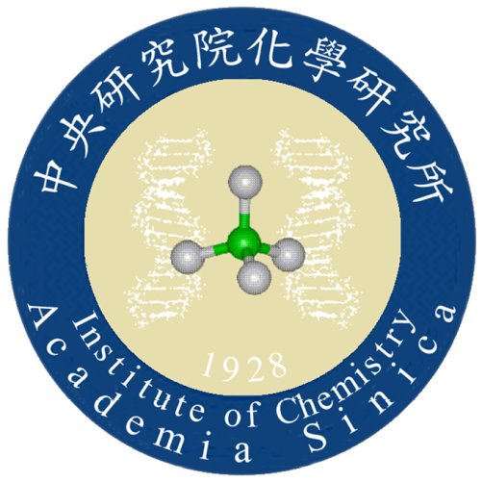
Python basics
Ching-Cher Sanders Yan 顏清哲
ccsyan@gmail.com
Institute of Chemistry, Academia Sinica
2022 Feb. 8th

Slide 3
Anaconda Installation

Slide 4
Updating Anaconda
Prompt
Run as Administrator

Slide 5
Updating Anaconda
Change to working directory
conda update --all

Slide 6
Starting Anaconda
Anaconda
Jupyter
Spyder

Slide 7
Anaconda

Slide 8
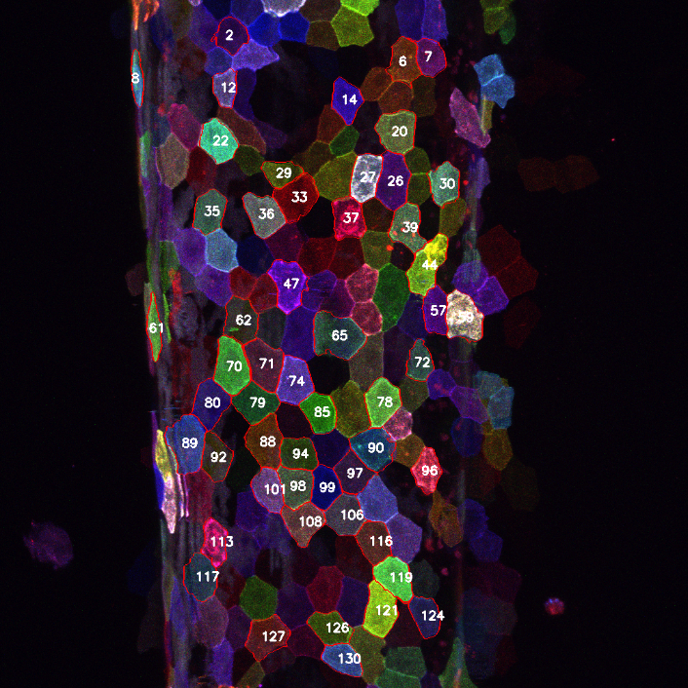
Downgrade to older version of Python
For functions being patented.
SIFT (Scale-invariant feature transform)

Slide 9
Jupyter
Start here

Slide 10
Jupyter from your web browser

Slide 11
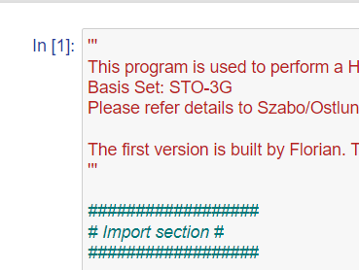
Jupyter: run a cell by shift + enter

Slide 12
Spyder
Start here

Slide 13
Spyder interface

Slide 14
Plot a function
Import
# markup, comments, ‘’’ … ‘’’
Assigning values to variables
Variables’ name rule: not start with a number
np.linspace, if you can find a function, don’t write yourself.
ts is an array, calculations involving one array making the same size output array.

Slide 15
Plot a function (2)
Calculations involving more than one array:
Size not match error
Expand to a two-dimensional array (a matrix)
Plot with legends
Unicode symbols
Google to code
Plot format for submitting your work

Slide 16
The output figure

Slide 17
ODE solver (b.plot_ode.py)
from scipy.integrate import odeint
def your own function with return
Local and global variables
Odeint inputs
Array.flatten(), but may not be necessary
Comparing between odeint and Euler method

Slide 18
Euler method and for loop
For efficiency, array operation is preferred.
for i in range(0, end):

Slide 19
b.plot_ode.py output figure

Slide 20
ODEs

