Slide 1
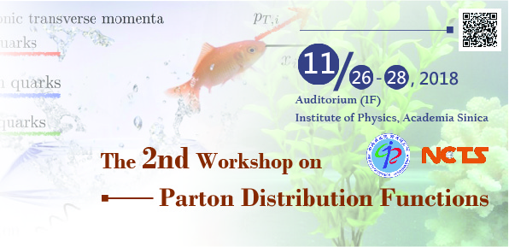

Pion induced Drell-Yan process within TMD factorization
Zhun Lu （吕准）
Southeast University (SEU)
Based on Xiaoyu Wang, ZL, Ivan Schmidt, JHEP 1708, 137 (2017) Xiaoyu Wang , ZL , PRD 97, 054005 (2018)
Xiaoyu Wang, ZL , EPJC, 78, 643 (2018)

Slide 2
OUTLINE
1. Introduction
2. Transverse momentum distribution of the dilepton in Unpolarized πN Drell-Yan process, extraction of the pion Sudakov form factor
3.Sivers asymmetry in transversely polarized π-proton Drell-Yan process within TMD factorization
5. Summary
4. Cos2φ asymmetry in the unpolarized π-proton Drell-Yan within TMD evolution at COMPASS

Slide 3


Introduction--Motivation
Test of the sign change of the Sivers/Boer-Mulders function is a fundamental quest in QCD dynamics. Recent measurement by COMPASS provides some hint on this sign change.
Precise measurement and extraction of the proton Sivers/Boer-Mulders function and pion Boer-Mulders function.
Studying the angular distributions in pion-induced Drell-Yan may shed light on the perturbative and nonperturbative origins of the Lam-Tung violation
It is also important to acquire the differential cross-section of the unpolarized process with high accuracy, as it always appears in the denominator of various asymmetries and angular coefficients.

Slide 4
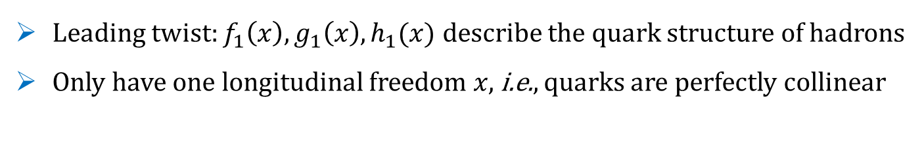
(TMD)PDFs
Drell –Yan is powerful in probing the partonic structure of hadrons: Parton Distribution Functions(PDFs)
Leading twist: $f_{1}\left(x\right), g_{1}\left(x\right), h_{1}(x)$ describe the quark structure of hadrons
Only have one longitudinal freedom $x,$i.e., quarks are perfectly collinear
Transverse Momentum Dependent(TMD) PDFs
Admit intrinsic parton transverse momentum
Provide 3D image of hadrons in momentum space: f (x,k_{T})
Spin-orbit correlation

Slide 5
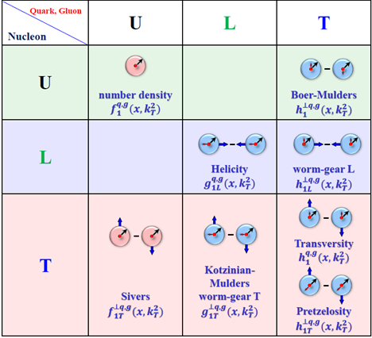
TMD-PDFs
Leading-twist
Unpolarized
TMD-PDFs give the number density of partons, with their intrinsic motion and spin, inside a fast moving proton, with its spin.
Longitudinally
polarized
Transversely
polarized

Slide 6
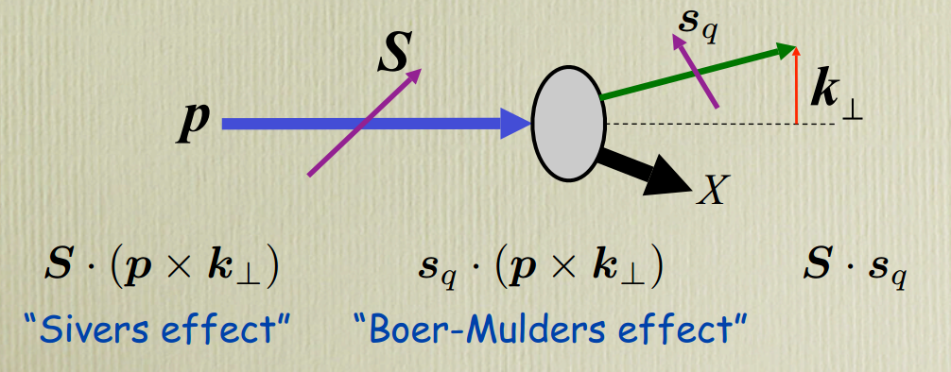
Spin-orbit correlation—— T-odd TMDs
Sivers function: correlation between the transverse spin of the nucleon and
parton transverse momentum
Boer-Mulders function: correlation between the transverse spin of the quark and quark transverse momentum
PDF

Slide 7
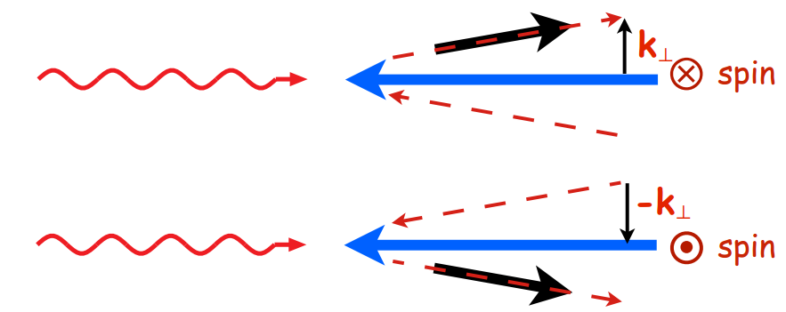






T-odd TMDs—— Physical picture
or >0 : the quark prefers to move upwards if the proton is moving to the left and the proton/quark spin is pointing towards the observer.
Give rise to SSA or
Azimuthal asymmetry
PDF

Slide 8
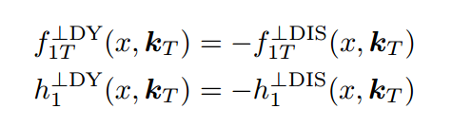
T-odd TMDs—— sign change
  Universality: TMDs might not be universal when probed through different hard scattering processes ---- an important property
DIS: Final-State
DY: Initial-State
Under time-reversal

Slide 9
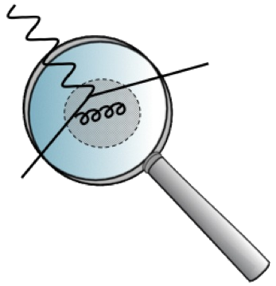
TMD evolution
Collinear PDFs
TMDs
Collins-Soper/rapidity evolution equation
Resum
Kernel: can be non-perturbative when
DGLAP evolution
Resum
Kernel: purely perturbative
Just like collinear PDFs, TMDs also depend on the scale of the probe = evolution
TMD

Slide 10

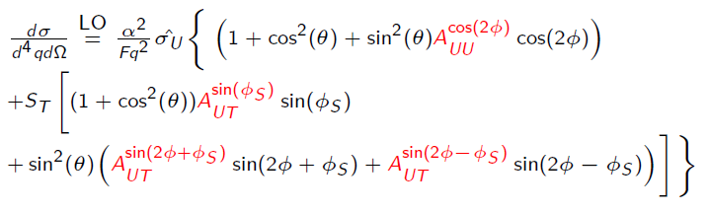

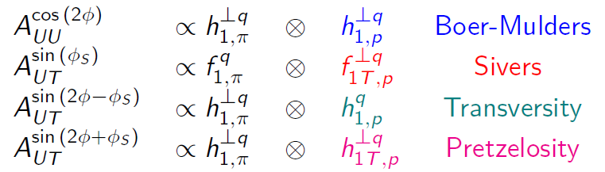

Spin/azimuthal asymmetries
General form of the cross section (Target: unpolarized/transversely polarized)
Leading-twist
Beam Target
Asymmetries
Boer-Mulders
Boer-Mulders
Boer-Mulders
Cross section

Slide 11
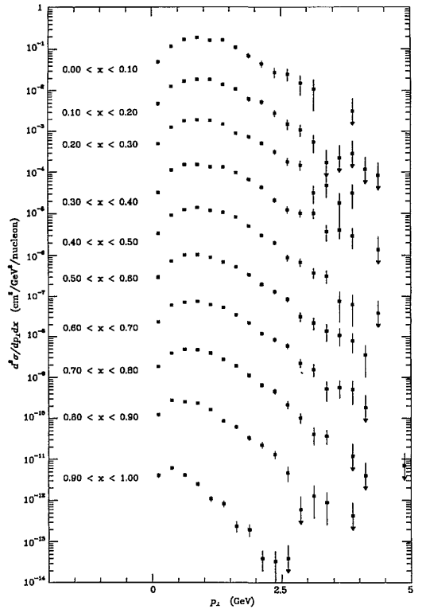
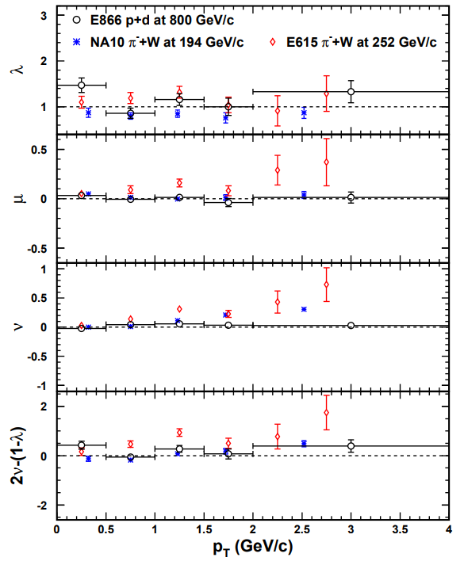
Experimental measurements
Pion-N Drell-Yan: early measurements (Unpolarized)
E615
NA10
E615
q_{T} distribution of dilepton
Angular coefficients

Slide 12
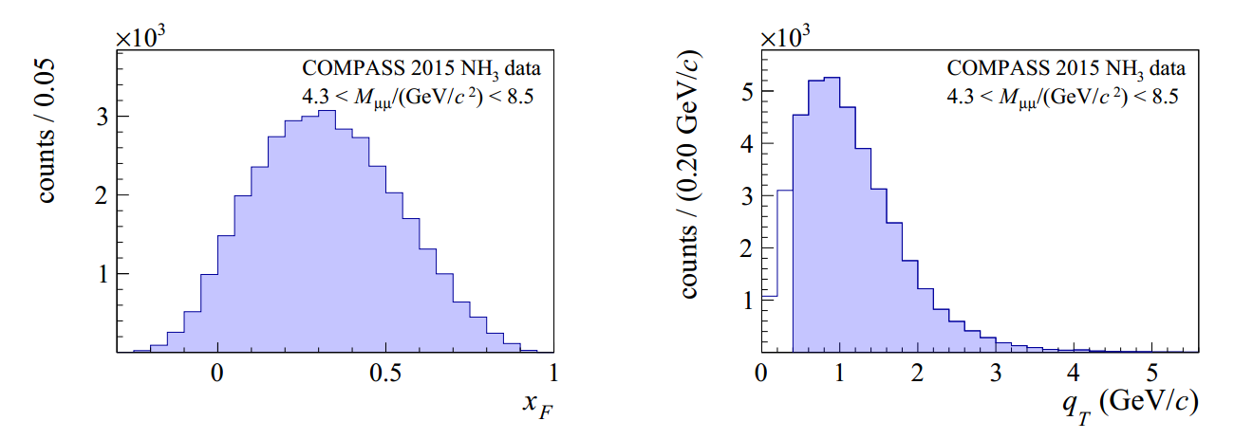


Recent COMPASS measurements
Pion-N Drell-Yan: Experimental measurements (Unpolarized)
PRL119, 112002 (2017)
distribution of dilepton events
distribution

Slide 13
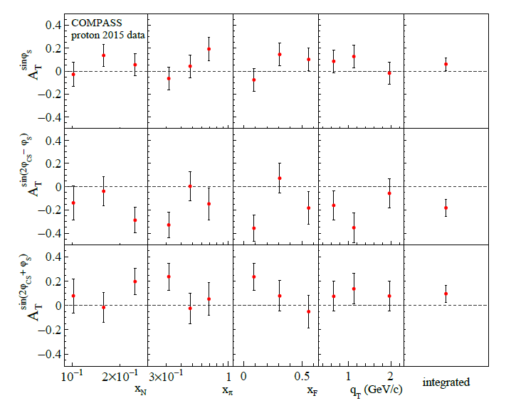
SSAs in DY at COMPASS
Experimental measurements (transversely polarized target)
Phys. Rev. Lett. 119, 112002 (2017)

Slide 14
OUTLINE
2. Extraction of pion Sudakov form factor from unpolarized πN Drell-Yan process

Slide 15
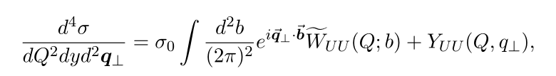





Unpolarized process — cross section
General form of the differential cross section (CSS resummation)
Collins, Soper and Sterman, NPB 250 (1985) 199
Studied by Collins et. al.,
PRD94,034014, 16’
tree level cross section
dominates in the region , all-order resummation
provides corrections at , ignored here
General form of differential cross section

Slide 16

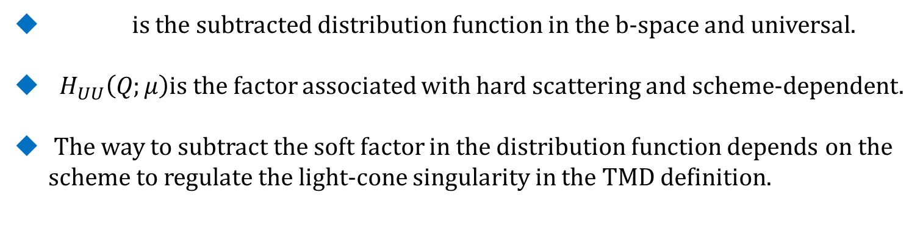


Unpolarized process
The structure function ${\tilde{W}}_{UU}$ can be written as
structure function
The way to regularize light-cone singularity in TMD definition and subtract soft gluon contribution defines the scheme for the TMD factorization

Slide 17

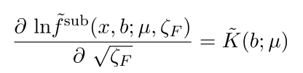
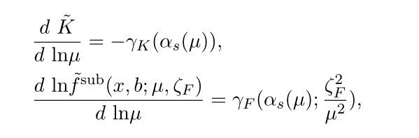

Unpolarized process -- evolution
TMD evolution for the -dependence (energy evolution)
Collins, Soper 81’
Idilbi, Ji, Ma, Yuan 04’
Evolution for the μ-dependence
General structure of the solution
TMD evolution

Slide 18
Unpolarized process -- evolution
Fourier transform back to the momentum space, one needs the whole b region (large b): need some non-perturbative extrapolation
  Many different methods/proposals to model this non-perturbative part
longitudinal/collinear part
transverse part
(perturbative)
Non-perturbative: fitted from data
Collins, Soper, Sterman 85, ResBos, Qiu, Zhang 99, Echevarria, Idilbi, Kang, Vitev, 14,
Aidala, Field, Gamberg, Rogers, 14, Sun, Yuan 14, D’Alesio, Echevarria, Melis, Scimemi, 14, Rogers, Collins, 15, … mostly for the proton case

Slide 19
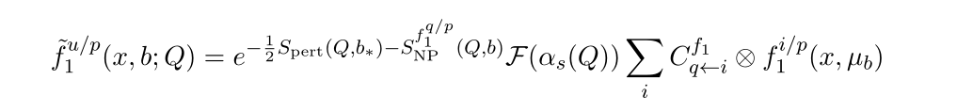






Unpolarized process—solution
Solution in b space
The way to regularize light-cone singularity in TMD definition and subtract soft gluon contribution defines the scheme for the TMD factorization
Collins, Soper 81’ Collins, Soper, Sterman 85’
Collins, 11’ Collins, Rogers 15’ Ji,Ma,Yuan 04’
CSS prescription
, : scheme-dependent coefficients/factors
Prokudin, Sun, Yuan 15’
Ji-Ma-Yuan (JMY) scheme: Ji,Ma,Yuan, PRD71, 034005; PLB 597,299
Collins-11(JCC) scheme: J. C. Collins, Foundations of perterbative QCD
Lattice (LAT) scheme: Ji,Ma,Yuan, PRD91, 074009

Slide 20

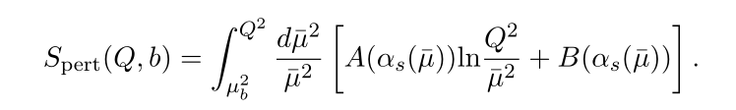


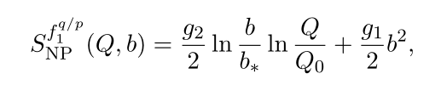

Sudakov-like form factor
The Sudakov-like form factor
The perturbative part of S (we adopt A and B up to NLL accuracy )
non-perturbative form factor of S from pp DY (SIYY parameterization )
Sun, Isaacson, Yuan, Yuan 14’
Parameters:

Slide 21






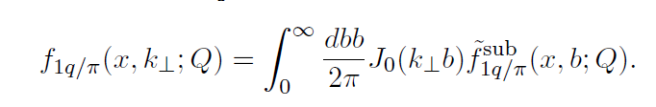
Sudakov form factor of the pion
Propose a similar non-perturbative Sudakov form factor
for pion TMD
Wang, Lu, Schmidt, JHEP 1708, 137
contains information on the nonperturbative
transverse motion of partons inside pion
The unpolarized TMD distribution for the pion

Slide 22
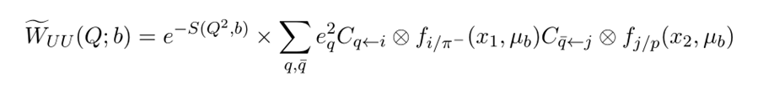
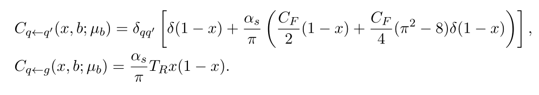

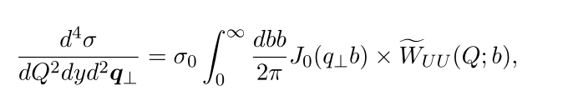
Unpolarized process
~
Structure function
Coefficients(scheme-independent coefficients)
S. Catani et.al, 01’
Differential cross section

Slide 23


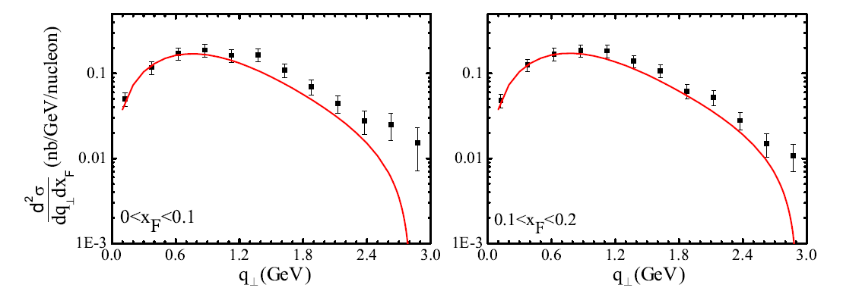
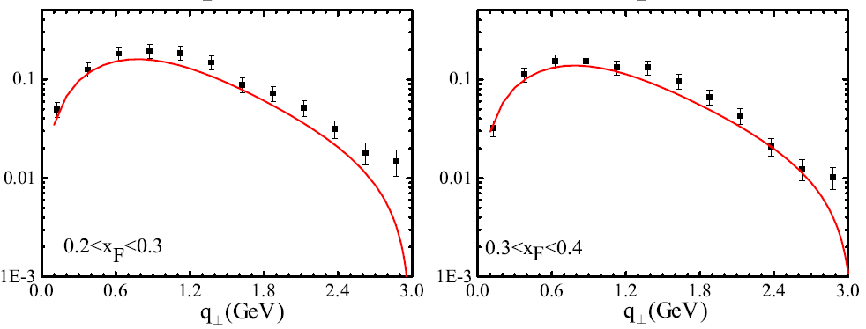
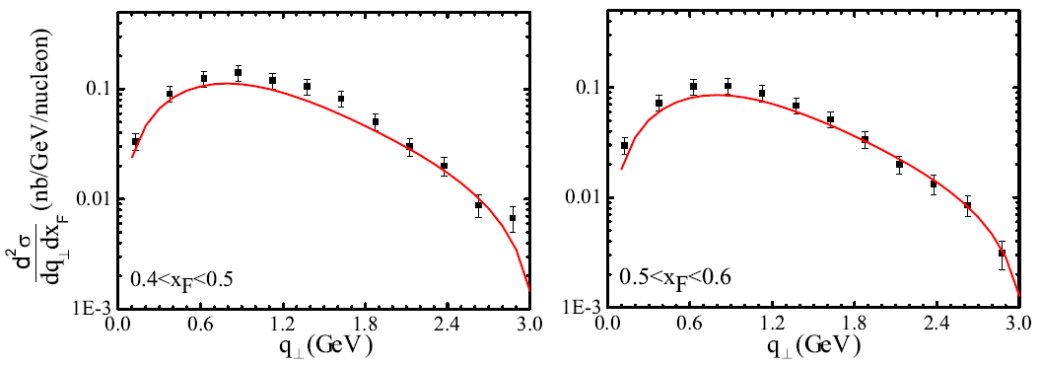
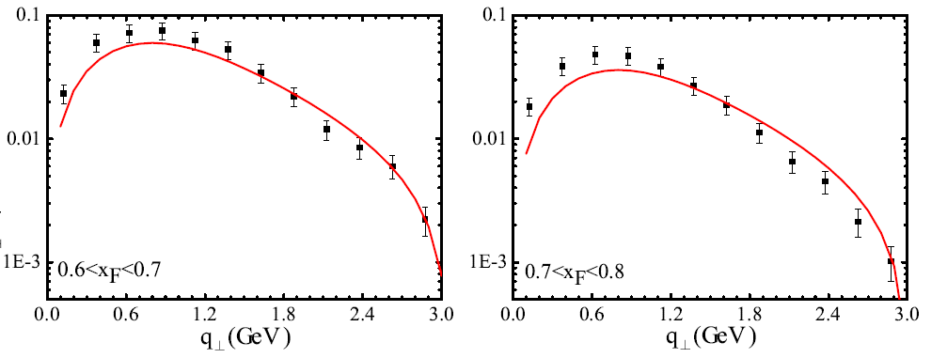
Unpolarized process
Fit to E615 q_{T} data,
Wang, ZL, Schmidt, JHEP 1708, 137
q_{T} < 3 GeV

Slide 24
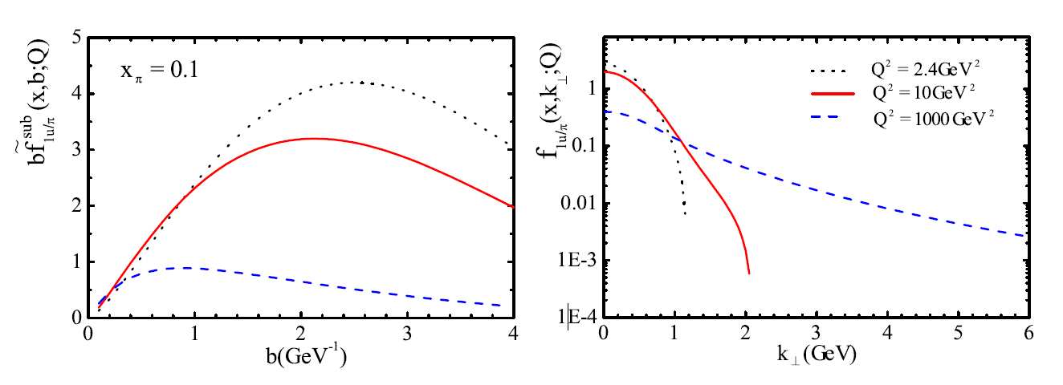
Evolution of pion TMD
~
the peak of the b-dependent distribution function moves towards the higher b region when decreasing energy scales
At high energy scale the distribution has a tail falling off slowly at large k_{T}
Wang, Lu, Schmidt, JHEP 1708 (2017) 137

Slide 25
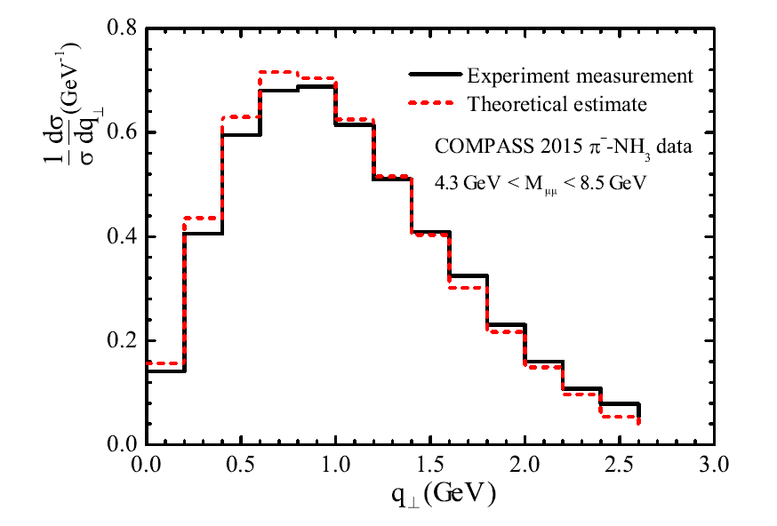
Transverse at COMPASS

Slide 26
OUTLINE
3. Sivers asymmetry in transversely polarized πN process

Slide 27
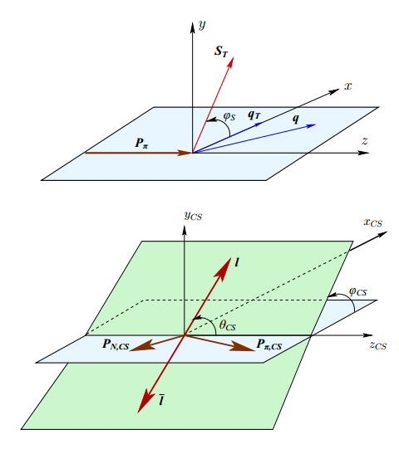
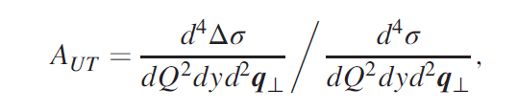
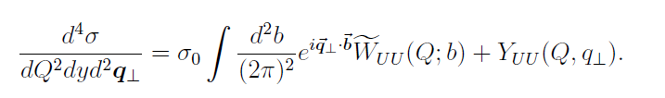

Transversely polarized process
The transverse single spin asymmetry can be defined as
Spin-dependent
Spin-independent(Unpolarized)
Sivers Asymmetry

Slide 28


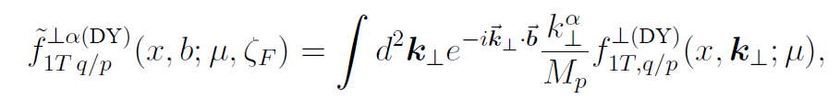

Transversely polarized process
Spin-dependent structure function
=
Sivers function in b-space
TMDs follows the same evolution equation in the perturbative region.
The evolution for can be written in a similar form.
Echevarria, Idilbi, Kang, and Vitev, 14’

Slide 29
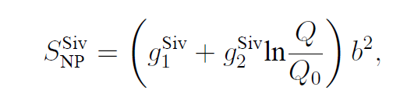


Transversely polarized process
for the Sivers function has the same form as unpolarized PDF
Nonperturbative Sudakov form factor for the Sivers function
Echevarria, Idilbi, Kang, and Vitev, 14’
Sudakov form factor for Sivers function

Slide 30
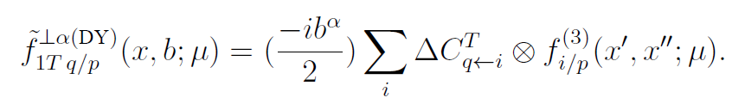


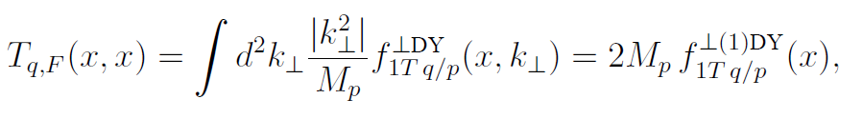
Transversely polarized process
In the small b region, the Sivers function can be also expressed as the convolution of perturbatively calculable hard coefficients and the corresponding collinear twist-3 correlation functions
Qiu-Sterman matrix element
is the most relevant one
small b region

Slide 31
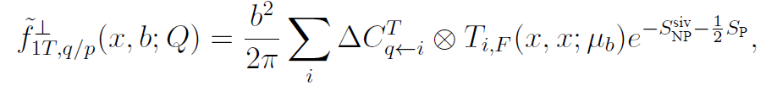
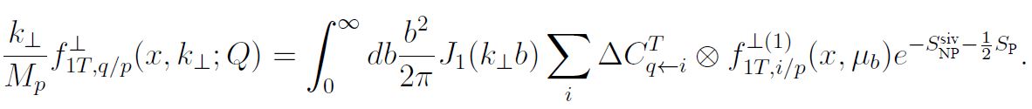
Transversely polarized process
Evolution of the Sivers function in the b space
Sivers function in the transverse momentum space
Sivers function

Slide 32
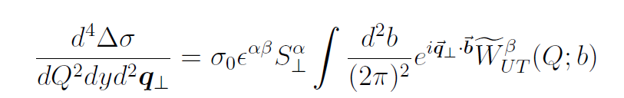
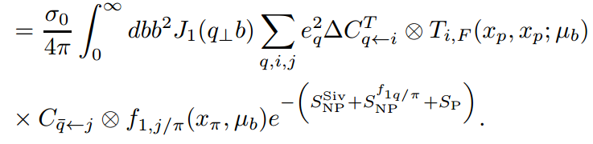
Transversely polarized process
The spin-dependent differential cross section
Kang, xiao, Yuan, 11’
Sun, Yuan 13’
We adopt the C-coefficient up to NLO
Spin-dependent

Slide 33
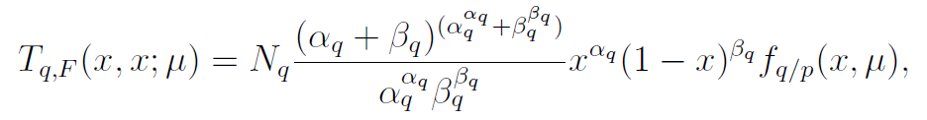
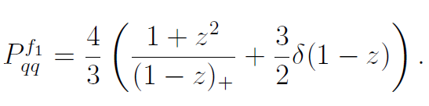
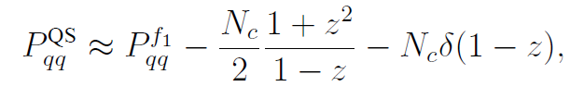
Transversely polarized process
Parameterization of the Qiu-Sterman function (EIKV14)
Echevarria, Idilbi, Kang, and Vitev, 14’
Set 1:the same as that of unpolarized PDF
scale dependence
Set 2:adopt an approximate evolution kernel
from homogenous terms in the exact solution
Qiu-Sterman

Slide 34
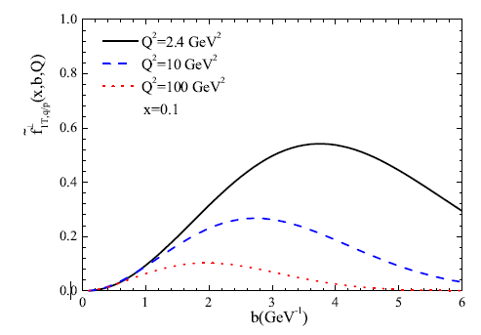
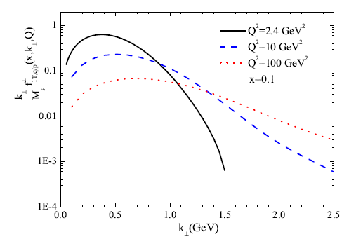
Transversely polarized process
TMD evolution of the Sivers function --Set 1
Wang, ZL, PRD 97, 054005 (2018)

Slide 35
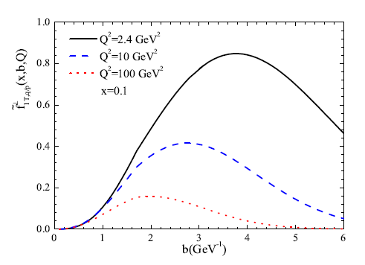
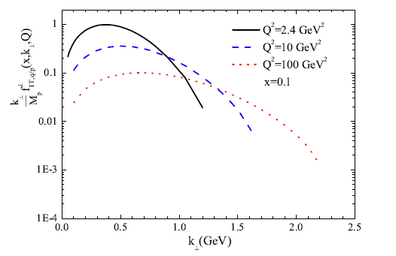
Transversely polarized process
TMD evolution of the Sivers function --Set 2
Wang, ZL, PRD 97, 054005 (2018)

Slide 36
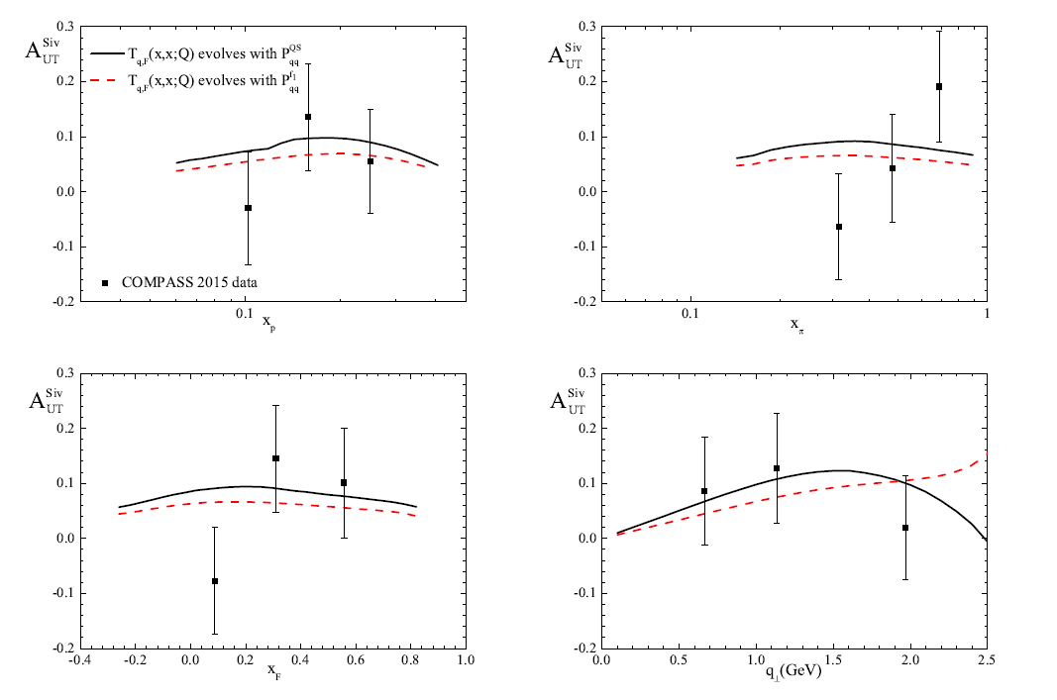
Transversely polarized process
Sivers asymmetry with the COMPASS measurement
Wang, ZL, PRD 97, 054005 (2018)

Slide 37
OUTLINE
4. Cos2φ asymmetry from BM function in the unpolarized πN DY

Slide 38

cos2φ asymmetry in pi-N Drell-Yan
    
  
    
• “naive” Drell–Yan model
collinear (k_{T}=0) LO pQCD no radative processes
λ=1, μ=ν=0
• Intrinsic transverse motion + QCD effects
λ≠1, μ ≠ 0, ν ≠ 0 but 1–λ 2ν (Lam-Tung)

Slide 39
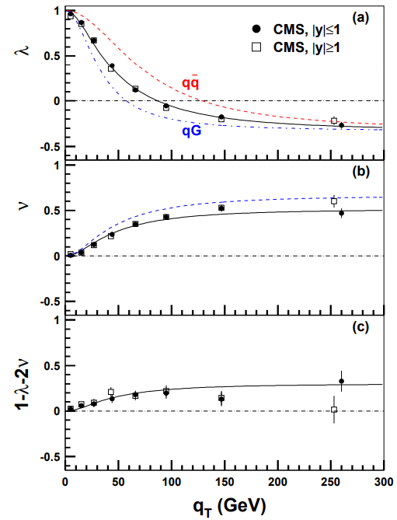


cos2φ asymmetry in pi-N Drell-Yan
• explanation for nonzero ν ≠ 0
- non-coplanarity, QCD radiative effects:
PRD93, 114013 (2016)
non-coplanarity
There might be some room for other effects
Peng, Chang, McClellan, Teryaev, PLB 758 384

Slide 40


cos2φ asymmetry in pi-N Drell-Yan
Cos2φ asymmetry contributed by the Boer-Mulders functions
Boer, 99’
It might be measured through combination (eliminate pQCD contribution):
Sudakov effect for Cos2φ asymmetry has been studied by Boer 01’

Slide 41



cos2φ asymmetry in pi-N Drell-Yan
In leading order
Chiral-odd Twist-3 function
Assuming the Sudakov form factor associated with the Boer-Mulders function is the same as that for the unpolarized distribution,

Slide 42

cos2φ asymmetry in pi-N Drell-Yan
TMD evolution of the pion Boer-Mulders function
Wang , Mao, ZL, EPJC78, 643 (2018)

Slide 43




cos2φ asymmetry in pi-N Drell-Yan
Numerator

Slide 44

cos2φ asymmetry in pi-N Drell-Yan
Boer-Mulders asymmetry at COMPASS
Wang , Mao, Lu, EPJC78, 643 (2018)
Boer-Mulders of the proton
adopted from PRD81,034023
Bands correspond to the
Uncertainty of the proton BM,
Which is not well contstrained

Slide 45
Summary
The Sudakov form factor for the unpolairzed TMD of the pion is extracted for the
first time from the E615 DY data within the TMD factorization incorporating TMD evolution.
The transvere momentum spectrum of the dilepton agrees with the COMPASS measurement at small q_T region, indicating that our approach can be used a first step for precision study of pion-nucleon DY.
The Sivers asymmetry calculated from the TMD evolution formalism is qualitatitvely consistent with the data at COMPASS. Prediction on the cos2phi asymmetry from the Boer-Mulders function is also presented.
The results might be improved by including higher order calcuatoin of the hard coefficients , and with more flexible parameterization on the nonperturbative part.
The framework applied here can be also extended to the study of the other azimuthal asymmetries in the pion-nucleon DY.

Slide 46


THANK YOU!

Slide 47

Test of sign change at COMPASS
PRL119, 112002 (2017)
DGLAP: Anselmino, Boglione, D’Alesio, Murgia, Prokudin , JHEP04,046
TMD-1 : Echevarria, Idilbi, Kang, Vitev, PRD89,074013
TMD-2 : Sun, Yuan, PRD88,114012

