Slide 1
Evolution of Extremely Light Axion Perturbations in Radiation Era
Tzihong Chiueh
National Taiwan University
in collaboration with
U.H, Zhang, H.Y. Schive, K.H. Leong
Zhang & Chiueh, PRD (2017 a, b}; Schive & Chiueh MNRAS (2017); Schive et al., ApJ (2017); Leong, Schive & Chiueh, et al. (2018, TBS)

Slide 2
Outline:
Brief introduction to wave dark matter
Motivations: Ly-α forest tension
Free-particle ψDM power spectrum
Extreme Axion power spectrum
Resolving Ly-α forest tension

Slide 3
Trouble with CDM
Non-detection of WIMPS (few 100 GeV)
Small-scale (~ kpc) problems:
(a) Missing satellite dwarf galaxies inside
massive galaxies, such as Milky Way by
a factor 10
(b) Flat-cores in dwarf galaxies

Slide 4



Wave Dark Matter (ψDM)
m_{a} = 10⁻²² eV, n₀ = 10²⁵${(1+z)}^{3}$/cc, T_{c} ~ 10(1+z) keV
Bose-Einstein condensate described by a single wave function ψ
Δx • Δv =ħ/m_{a}~(16km/s)kpc astronomical scale
Expect the uncertainty principle operate in Milky Way
Δv ~ 160km/s Δx ~100pc, small scale!
On the other hand, G demands large scale structures
Solution has small & large scales co-exist !
What if G and ħ/m_{a} balance and share the same scale?
R_{s}•M_{s}=(ħ/m_{a})²/G --- high density ground state
R_{BH}/M_{BH}= G / c² --- black hole analogy, G balances c

Slide 5
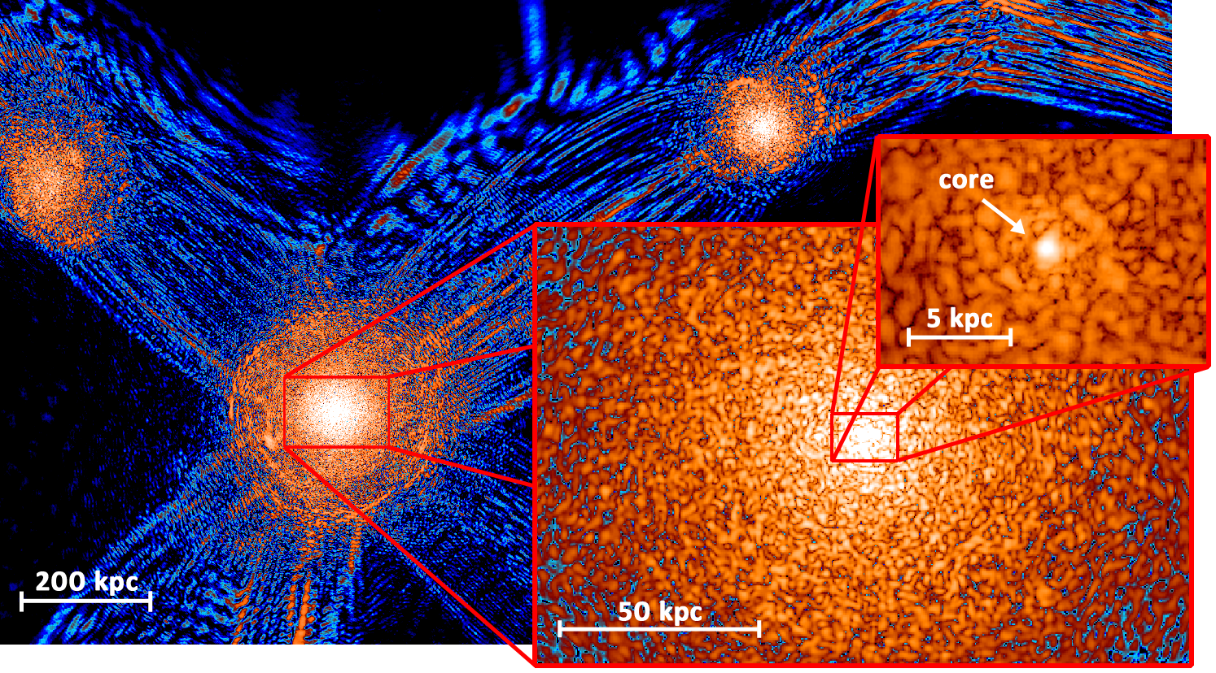
Soliton core in every galaxy
Turns out stars reside in the solitin core of dwarf galaxies
Use Δv ~ 16km/s Δx ~1 kpc, typical size of dwarfs

Slide 6
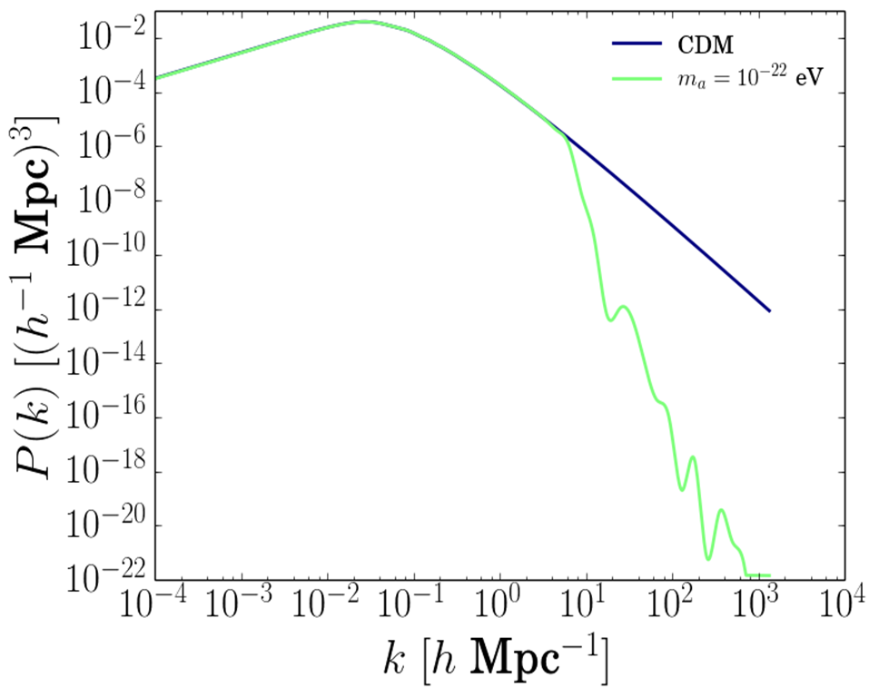
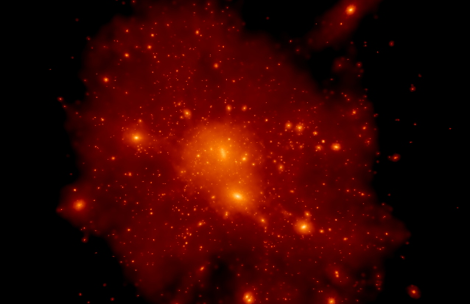


Explain Missing Satellite Galaxies
Hu et al.(2000) predicted small scale suppression
cutoff k ~ $m^{1/2}$
z=3000
z=10
evolving matter spectrum
CDM simulation of a major halo hundreds of dwarf galaxies, but NOT SEEN!
Quantum Jeans wavenumber k_{J}² ~ ρ/c_{s}² ~ a^{1/2}
c_{s}² replaced by Δ$v^{2}$ ~ (ħ/m_{a})² k²
Woo & Chiueh, ApJ (2009)

Slide 7

Motivations:
Try to understand why free-particle ψDM has a small-scale suppression in the radiation era
Lyα forest spectrum (z = 2-4.5) demands m > 30x ${10}^{−22}$ eV to be consistent with data (2017 a, b)
Find a way out by modifying the fp ψDM model
Simulation of CDM Lyα flux spectra
comparisons with the power spectra of flux spectra

Slide 8
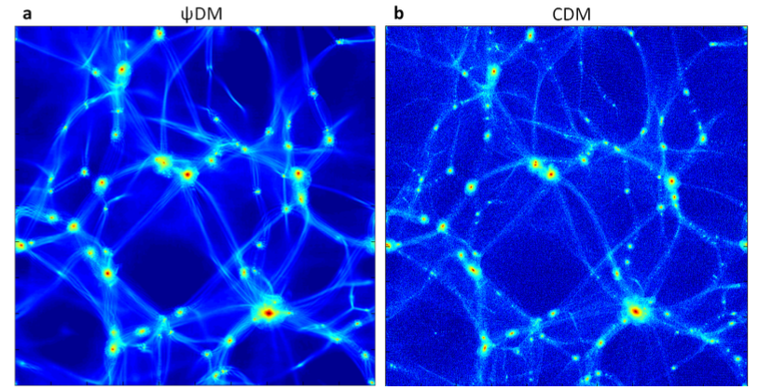
Lyα absorption features are dominated by less evolved filaments, not by highly evolved halos since no signal there. Hence Lyα keeps features of initial spectrum well
line of sight
1 Mpc

Slide 9
How to understand the ψDM small –scale suppression?
Zhang & Chiueh (a), PRD, 96, 023507(2017), 1702.07065 (PhD thesis)
130+ equations

Slide 10




Let the wave function be Ψ+ψ, and the potential perturbation be φ, the wave function satisfies
* Synchronous gauge
Friction Harmonic oscillation
^{damped harmonic oscillation}
$$a0^{}$$
$$a^{2}$$
*Background matter density <$Ψ^{2}$> ~ $a^{−3}$ after H ~ m a, where the field condense into a real particle
*Perturbations have additional $k^{2}$, but it only increases the spring constant producing beat freq in energy density.
^{CDM}
$$a^{6}$$

Slide 11
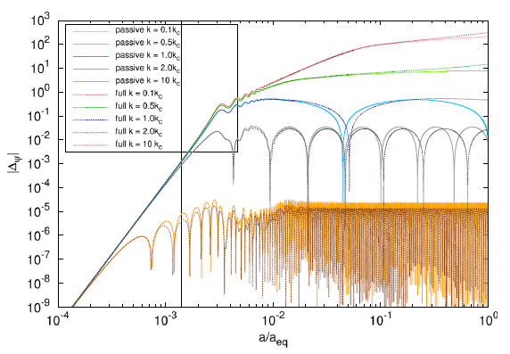
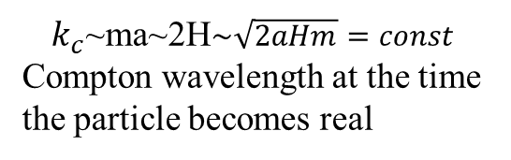
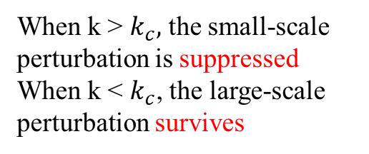
^{A useful approximation:} ^{the} ^{potential is entirely} ^{governed by radiation}
where $u_{k}$ = k/$\sqrt{3}$H
When k < 2H, superhorizon, φ stays constant
When k > 2H, subhorizon, the potential φ undergoes damped oscillations
3 frequency scales, k, H, ma (1)ma<k<2H, (2)k<ma<2H (3)k<2H<ma, (4)2H<k<ma,
high-freq mass oscillations
⁽⁴⁾
⁽³⁾
^{(5)ma<2H<k, (6)2H<ma<k}
$k_{c}$~ma~2H$\sim \sqrt{2aHm}=const$ Compton wavelength at the time the particle becomes real
low-freq beat oscillations
⁽²⁾
⁽⁶⁾
⁽⁵⁾
When k > $k_{c},$ the small-scale perturbation is suppressed
When k < $k_{c}$, the large-scale perturbation survives
⁽¹⁾
^{ma=H}
Rad-matter equality

Slide 12
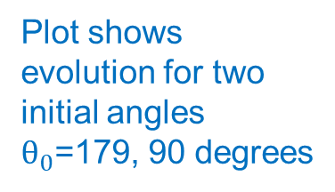
Extending Free-Particle model to Axion-like Model
long waves agree with CDM
CDM
shorter waves have less suppression
delay mass osc.
Plot shows evolution for two initial angles $θ_{0}$=179, 90 degrees
Zhang & Chiueh(b), PRD, 96,
063522 (2017), 1705.01439

Slide 13
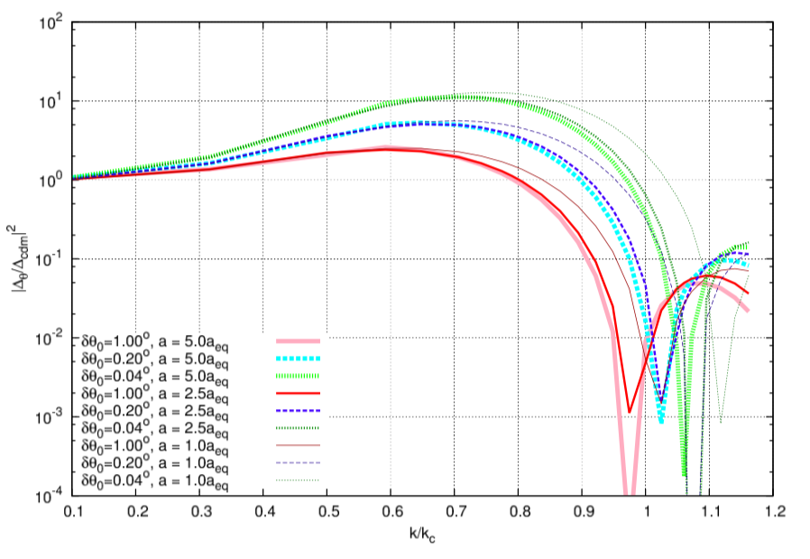



Extreme Axion power spectrum coming out of radiation era
evolution of 3 model spectra
10¹⁰ Msun
δθ
CDM
k²
Change the landscape of high-z universe, Schive & Chiueh . MNRAS(2017)
Usual sub-compton scale suppression
Parametric instability, δθ with time but for a short period
Delayed oscillation avoids Hubble friction, instability takes off
Growth factor ~ k² for low k < $k_{c}$ since long waves enter horizon very late, thus no nonlinearity

Slide 14
Transfer functions of various angles
Confronting the Lyα Forest
Problem w/ Simulations
data range
BOSS Lyα data
z = 2.2-4.4
high and low resolutions
Nonlinear matter power spectra show that models can be distinct at small-scale and high redshifts
Lyα forest power spectrum versus best-fit curve of each model

Slide 15


Results:
420 bins of data, 26 fitting parameters for each model to minimize total $χ^{2}$
#
Implication:
CDM is outside 5σ confidence of the best model, where
$θ_{0}$= 2.5 degrees from the potential top
@
#
*
K.H. Leong’s Master thesis

Slide 16
Conclusion
Brief review on wave dark matter (ψDM) which solves small-scale problems with the help of suppressed matter spectrum and soliton. But other challenges ahead…..
Compton small-scale suppression of ψDM in rad era and
Compton k in rad era Jeans k in matter era
Extreme Axion ψDM enhanced intermediate scale power about 10¹⁰ Msun, can solve the Lyα problem, and can change landscapes of early universe when the first galaxies formed

