Slide 1
A rotating hairy BH in AdS_3
9th Taiwan String Workshop
November 11-13 , 2016
National Tsing Hua University, Hsinchu, Taiwan
Kyung Kiu Kim (Yonsei Univ.)
In collaboration with
Byoungjoon Ahn, Seungjoon Hyun, Sang-A Park and Sang-Heon Yi (Yonsei Univ.)

Slide 2
Outline
Motivation
The hairy BH in the bulk point of view
The hairy BH in the boundary point of view
On-shell action
Summary

Slide 3
Motivation
There are many hairy black holes in AdS and AdS/CFT provides dual meaning to such solutions in the field theory side.
These hairy solutions can be related to some phase transitions or sourced physics in the field side.
Recently there have been much of development of rotating hairy black hole solutions and the dynamical Smarr relation of time dependent black holes.
Since the low dimensional physics can be understood more consistently than higher dimensional cases, we are interested in AdS_3 black holes.
The AdS_3 black holes are dual to thermal states of 1+1 dimensional field theory which has integrable structures in some case.

Slide 4
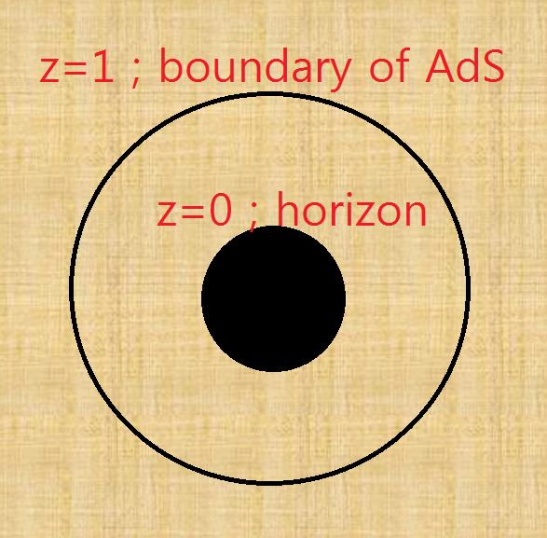
A hairy BH in the bulk point of view
The rotating BTZ black hole

Slide 5
The Action of the system
We would like to add a matter to make a hairy configuration.
This system was studied in Our setup is based on this paper.

Slide 6
What kind of hairs can exist? VS
Let us consider mass of the hairs?

Slide 7
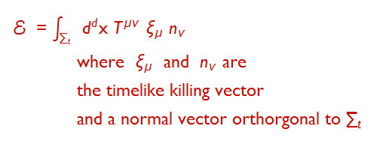
Normalizable mode?
Normalizable hair, Normalizable mode, Normalizable Energy !
The normalizability depends on the asymptotic behavior of the scalar field.

Slide 8
Asymptotic solution of the scalar field
Then the energy or mass of the hair becomes
We are not interested in too heavy hairy configurations.

Slide 9
If the scalar mass is between -1 and 0, a hairy BH has finite energy.
When do the hairy configurations appear?
In order to see this, we need to investigate the instability of the Rotating BTZ.
Instability of a black hole? Quasi-normal mode!
Quasi normal mode of the scalar is given by Linear fluctuation in the rotating BTZ background
Ansatz for the scalar field

Slide 10
This equation admits a general solution.
By ingoing boundary condition at the horizon z=0, C_1 = 0.
Futhermore, we may think the boundary condition at z=1, the boundary of AdS space?
For convenience, we take the mass square as -8/9.
This is a solution of a linear equation, so overall size can be absorbed by a scaling. Let us choose the ratio of A and B as

Slide 11
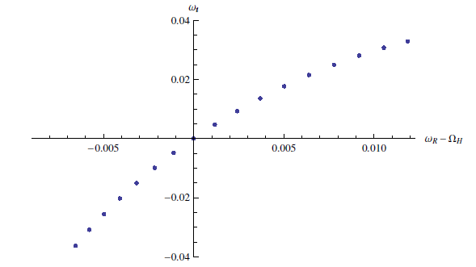
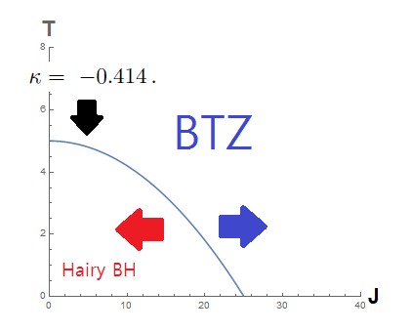
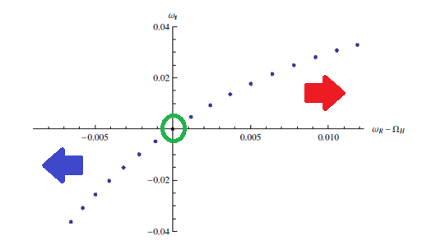
Frequencies satisfying the boundary conditions are as follows:
Angular velocity, Angular momentum, Temperature and Mass

Slide 12
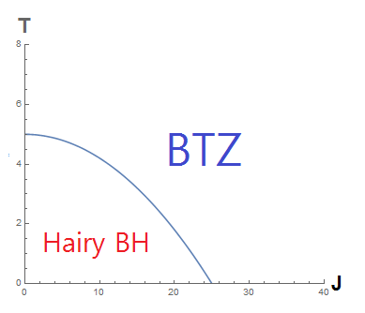
Real Phase diagram ?
If it is true,
there should be a phase transition between a BTZ and a Hairy BH.
In low temperature and Small Angular momentum, a rotating BTZ BH could change to a hairy BH.

Slide 13
In order to conclude the existence of this phase transition, we have to compare the free energies of the both solutions.
The phase transition in the micro-canonical ensemble was studied in the paper by Iizuka et al.
We will try to understand the phase transition in other ensemble by comparing Euclidean on-shell action. This ensemble is a kind of the grand canonical ensemble where the angular velocity plays a role of a chemical potential.
This can be well understood through AdS/CFT.

Slide 14
A hairy BH in the boundary point of view
Before calculating the on-shell action, let us explain how this transition can be depicted through AdS/CFT correspondence.
AdS/CFT can be expressed by following equivalence of two partition functions.
In some limit( large N with fixed coupling or classical gravity limit ) This equivalence changes into
Indentifying the both sources or the boundary conditions is important.

Slide 15
Usually the source is taken as a non-normalizable mode in the gravity theory and also a source of an operator(Chiral primary) in the dual CFT.
In this model, we have two bulk fields.
Each field has non-normalizable mode.
The source in the field theory can be identified with the non-normalizable modes of the bulk fields.

Slide 16
These sources denote the metric and a source of a scalar operator in the dual field theory..
They appear in the field theory side.
The VEV of operators are given by

Slide 17
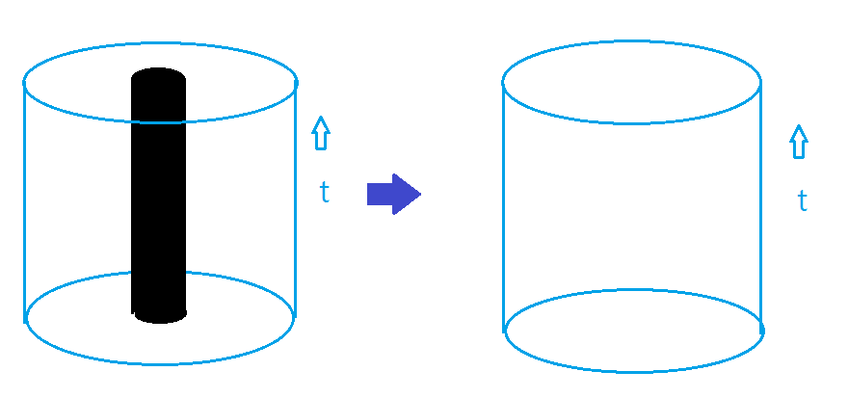
AdS_3 is dual to a CFT in R X S^1 .
In our case under consideration, the scalar doesn’t have any non-normalizable mode in the bulk.

Slide 18
The both modes are normalizable because we consider following BC.
One can interpret this BC through AdS/CFT dictionary.
Multi-trace deformation !
In the large N limit, a nontrivial effect remains in the gravity theory.

Slide 19
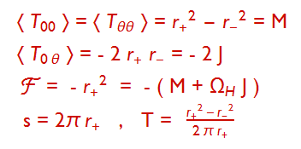
Boundary physical quantities for the rotating BTZ ;
Thermodynamic relation

Slide 20
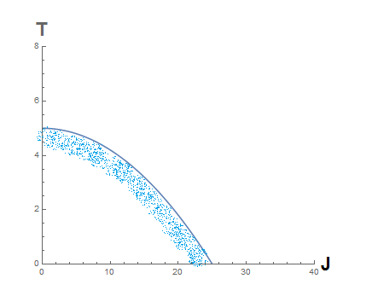
We would like to compute the on-shell action for the hairy BH and compare it to the on-shell action of the BTZ at the same angular momentum and temperature

Slide 21
In Iizuka et al, they found a perturbative solution up to ε^4 to see the phase transition.
We will consider the solution up to ε^2 to get the on-shell action.
Let us start with the following metric ansatz.
Then the perturbative metric and scalar field are given in the following form. Where the coordinate y is given by

Slide 22
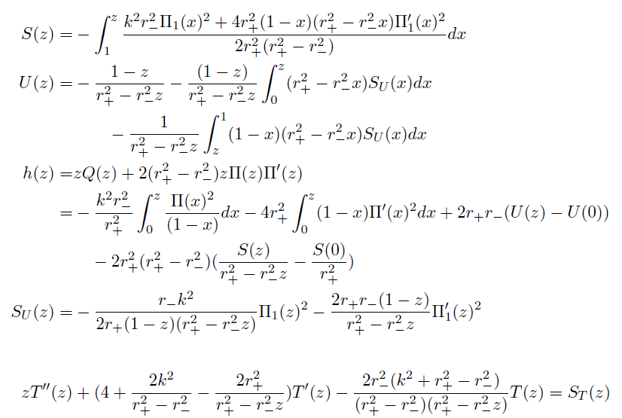
Up to ε^2 we have an analytic expression

Slide 23
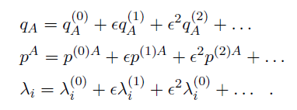
On-shell action
General expansion including counter term
Let us start with a general action
Expand the fields

Slide 24
By using the perturbative eoms, the on-shell action is given in the following form :
Back to our case

Slide 25
Plugging the fields into the general on-shell action, we can get
To get more explicit value we have computded the renormalized momenta.

Slide 26
The final on-shell action is by the boundary conditions

Slide 27
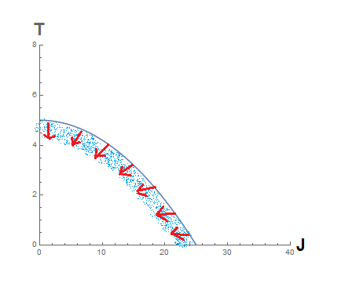
Comparison to the on-shell action of the BTZ
We found that the free energy of the hairy black hole is smaller than the free energy of the BTZ inside of the marginal stability curve.
Therefore, the second order phase transition occurs in small angular momentum and low temperature region.

Slide 28
Interpretation in the boundary theory :
There is a deformed CFT on S^1 by a double trace operator.
The normal state has a momentum flow. The flow is constant. There is no fluctuation in the spatial coordinate.
In low T and small J, the constant momentum flow changes to a lumpy flow.

Slide 29
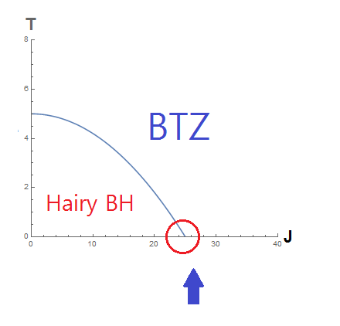
One interesting point is the zero temperature line.
This is a quantum phase transition.
Even the normal state is a superfluid state because the gravity dual is the extremal BTZ.
Thus the phase transition describes a transition between a superfluid phase to the broken phase.

Slide 30
Summary and ongoing direction
The rotating BTZ with a scalar field could have instabilities.
With some generalized boundary condition, there exists hairy configurations with finite energies.
This bulk physics is dual to a phase transition under the double trace deformation.
We calculated the on-shell action of the hairy configuration.
By comparison of free energies, we show that there is a second order phase transition.
We will investigate the zero-temp phase transition. This is a quantum phase transition.
We are finding non-perturbative numerical solutions sitting on deep-inside the phase diagram .

Slide 31
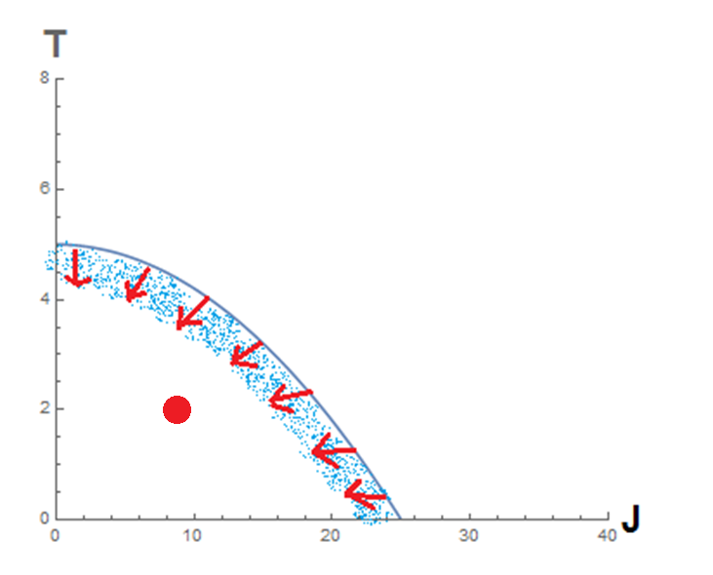
Thank you for your attention !

