Slide 1
Hyperscaling-violating Lifshitz hydrodynamics from black holes
Yoshinori Matsuo
National Taiwan University
In collaboration with Elias Kiritsis
arXiv:1508.02494
arXiv:1611.nnnnn

Slide 2
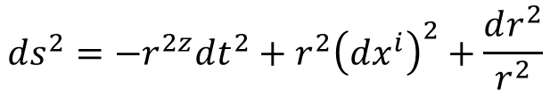
Introduction
The holography gives the correspondences between black holes and fluids.
[Son-Starinets, 02]
[Policastro-Son-Starinets, 02]
[Bhattacharyya-Hubeny-Minwalla-Rangamani, 07]
Lifshitz spacetimes give holographic description of the Lifshitz scaling invariant theories.
[Son, 08]
[Balasubramanian-McGreevy, 08]
$$ds^{2}=−r^{2z}dt^{2}+r^{2}{\left(dx^{i}\right)}^{2}+\frac{dr^{2}}{r^{2}}$$
[Kachru-Liu-Mulligan, 08]
[Taylor, 08]
Boundary theories in the Lifshitz spacetimes have the Newton-Cartan geometry, which is a non-relativistic gravity, as a background.
[Christensen-Hartong-Obers-Rollier, 14]
[Hartong-Kiritsis-Obers, 14, 14, 15]
Here we would like to see that
Fluid/gravity correspondence for the Lifshitz spacetime give a holographic description of fluids in Newton-Cartan background.
Notes:
In AdS/CFT correspondence, correspondence between black holes and fluids are studied.
By using the Lifshitz spacetime, we can consider the correspondence with anisotropic symmetry in temporal and spatial directions.
Field theories with Lifshitz symmetry will be non-relativistic. Then, the background in the boundary field theory in holography for Lifshitz spacetime will be the Newton-Cartan geometry which is a non-relativistic gravity.
We consider the correspondence between black holes and fluids in holography with Lifshitz symmetry and see how the Newton-Cartan geometry appears.

Slide 3

Fluid/Gravity correspondence
In CFT side, matters behaves as a fluid at finite temperature.
In AdS side, black holes appear at finite temperature.
Fluids in CFT corresponds to Black holes in AdS, at finite temperature.
For fluids
Energy density ($\sim$ temperature) depends on position $x^{μ}$
Horizon radius ($∼$ temperature) of BH depends on $x^{μ}$
Fluids have flow
introduce ($x^{μ}$-dependent) boost to BH geometry
The modified black hole solution describes fluids in dual field theory
We generalize the Fluid/Gravity correspondence to asymptotically Lifshitz spacetime.
Notes:
The correspondence between black holes and fluids can be seen in the finite temperature.
In field theory side, matters behaves as a fluid at finite temperature. In gravity side, there is a black hole.
Then, at finite temperature, fluids correspond black holes.
More precisely, in order to consider fluids, we have to modify black holes.
For fluids, the energy density shoud depend on position, and hence, the horizon radius of the black hole also must depend on x. In order to consider the flow of the fluid, we have to boost the black hole geometry.
After these modification, the modified black hole solution corresponds to the fluid.
We generalize this correspondence to the case of Lifshitz spacetime.

Slide 4

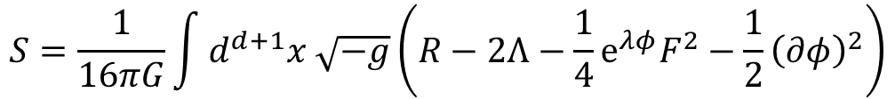







Einstein-Maxwell-Dilaton model
The action
$$S=\frac{1}{16πG}\int{d^{d+1}x \sqrt{−g}\left(R−2Λ−\frac{1}{4}e^{λφ}F^{2}−\frac{1}{2}{\left(∂φ\right)}^{2}\right)}$$
This model has the Lifshitz spacetime as a solution
$$λ^{2}=2\frac{d−1}{z−1}$$
$$ds^{2}=−r^{2z}dt^{2}+\frac{dr^{2}}{r^{2}}+\sum_{i}{r^{2}{\left(dx^{i}\right)}^{2}}$$
$$Λ=−\frac{\left(z+d−1\right)\left(z+d−2\right)}{2}$$
$$A=ar^{z+d−1}dt$$
$$e^{λφ}=μr^{2(1−d)}$$
$$μa^{2}=\frac{2\left(z−1\right)}{z+d−1}$$
The metric has Lifshitz scaling symmetry
$$t→c^{z}t$$
$$x^{i}→c x^{i}$$
$$r→c^{−1}r$$
Notes:
We consider the following action; it has the Einstein gravity, U(1) gauge field and dilaton.
This model has the Lifshitz spacetime as a solution.
In this solution, the metric has the Lifshitz symmetry. This symmetry has different scaling factor in time and spatial directions.

Slide 5

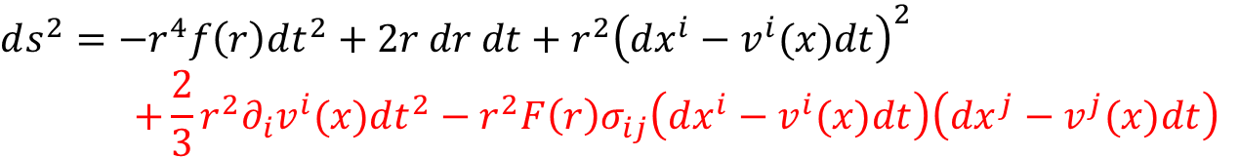



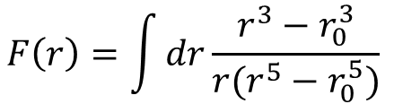

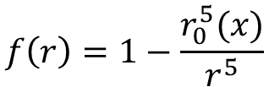

First order solution (for $d=4$, $z=2$)
We modify the asymptotically Lifshitz black hole solution and introduce the correction terms such that it is a solution of EOM.
$$ds^{2}=−r^{4}f\left(r\right)dt^{2}+2r dr dt+r^{2}{\left(dx^{i}−v^{i}(x)dt\right)}^{2}$$
$$+\frac{2}{3}r^{2}∂_{i}v^{i}(x)dt^{2}−r^{2}F\left(r\right)σ_{ij}\left(dx^{i}−v^{i}(x)dt\right)\left(dx^{j}−v^{j}(x)dt\right)$$
$$A=a(x)\left(r^{5}f\left(r\right)−\frac{1}{3}r^{3}∂_{i}v^{i}\left(x\right)\right)dt−a(x)r^{2}dr+𝒜_{i}(x)\left(dx^{i}−v^{i}(x)dt\right)$$
$$f\left(r\right)=1−\frac{r_{0}^{5}(x)}{r^{5}}$$
$$e^{λφ}=μ(x)r^{2(1−d)}$$
$$F\left(r\right)=\int{dr\frac{r^{3}−r_{0}^{3}}{r(r^{5}−r_{0}^{5})}}$$
$$σ_{ij}=∂_{i}v^{j}+∂_{j}v^{i}−\frac{2}{3}δ_{ij}∂_{k}v^{k}$$
It must satisfy the following constraints
$$0=∂_{t}r_{0}+v^{i}∂_{i}r_{0}+\frac{1}{3}r_{0}∂_{i}v^{i}$$
$$0=∂_{t}a+v^{i}∂_{i}a−a∂_{i}v^{i}$$
$$0=∂_{t}𝒜_{i}+v^{j}∂_{j}𝒜_{i}+𝒜_{j}∂_{i}v^{j}+a∂_{i}r_{0}^{5}$$
Notes:
We modify the black hole solution. We boost the metric and also introduce x-dependences into the parameters as velocity of boost, horizon radius and so on.
If we only introduce the x-dependence, the metric is no longer a solution of EOM. So, we consider the long wave length expansion, and add the correction terms, which are shown in red.
In order for the metric to be a solution, the parameters, which now depends on x, also must satisfy these equations.

Slide 6




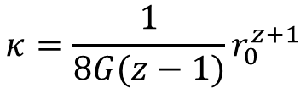






Stress-energy tensor for Lifshitz fluid
The stress-energy tensor is calculated from the solution by using GKPW as
$$T_{ 0}^{0}=−ℰ$$
$$T_{ 0}^{i}=−\left(ℰ+P\right)v^{i}+ησ_{ij}v^{j}+κ∂_{i}T$$
$$T_{ i}^{0}=0$$
$$T_{ j}^{i}=Pδ_{ij}−ησ_{ij}$$
The energy density, pressure and charge density are
$$ℰ=\frac{3}{16πG}r_{0}^{z+3}$$
$$P=\frac{z}{16πG}r_{0}^{z+3}$$
$$n=\frac{z−1}{16πGa}$$
$$T=\frac{z+3}{4π}r_{0}^{z}$$
The shear viscosity and thermal conductivity are
$$η=\frac{1}{16πG}r_{0}^{3}$$
$$κ=\frac{1}{8G(z−1)}r_{0}^{z+1}$$
Bulk viscosity vanishes.
Energy density and pressure satisfy the Lifshitz scaling condition
$$zℰ=\left(d−1\right)P$$
Notes:
Since we have obtained the solution for fluid in gravity side, we calculate the stress-energy tensor on the boundary.
We calculate the stress-energy tensor by using the GKPW relation, or in more detail, by using the formula by Balasubramanian and Kraus.
Then, we get this stress-energy tensor. From this, we can read off the energy density, pressure and charge density.
Also, we find the transport coefficient, shear viscosity and heat conductivity are calculated as this. The shear tensor sigma is traceless part and there are no trace part, which implies that the bulk viscosity is zero.
The energy density and pressure satisfies the ward identity for the Lifshitz scaling symmetry.

Slide 7



Non-relativistic fluid equations
Constraints for parameters $r_{0}$, $v^{i}$, $a$, etc. give fluid equations
$$0=∂_{t}ℰ+v^{i}∂_{i}ℰ+\left(ℰ+P\right)∂_{i}v^{i}−\frac{1}{2}ησ_{ij}σ_{ij}−∂_{i}\left(κ∂_{i}T\right)$$
$$0=∂_{i}P−∂_{j}\left(ησ_{ij}\right)+𝒥^{μ}ℱ_{μi}$$
$$0=∂_{t}n+∂_{i}\left(nv^{i}\right)$$
Ordinary fluid equations are
$$0=∂_{t}ℰ+v^{i}∂_{i}ℰ+\left(ℰ+P\right)∂_{i}v^{i}−\frac{1}{2}ησ_{ij}σ_{ij}−∂_{i}\left(κ∂_{i}T\right)$$
$$0=∂_{i}P+ρ∂_{t}v^{i}+ρv^{j}∂_{j}v^{i}−∂_{j}\left(ησ_{ij}\right)+J^{μ}F_{μi}$$
$$0=∂_{t}ρ+∂_{i}\left(ρv^{i}\right)$$
Energy conservation (1st line) and continuity equation (3rd line) agree.
But the Navier-Stokes does not agree.
The difference can be explained by using the Newton-Cartan theory.
Notes:
We can also calculate the equations for fluid. The parameters in the modified black hole solution must satisfy some conditions. They are actually, equivalent to the equations of motion for the fluid. We obtain the following equations.
They are similar to the equations for ordinary non-relativistic fluids; energy conservation, Navier-Stokes equation and continuity equation. The continuity equation and energy conservation equation agree. But our result does not have the terms which are indicated by red in the Naiver-Stokes equation.
This can be understood by using the Newton-Cartan theory.

Slide 8











Newton-Cartan geometry
Non-relativistic theory of gravity
Described by Newton-Cartan data $\left(τ_{μ} ,h^{μν}, {\overline{v}}^{μ}, {\tilde{A}}_{μ}\right)$
$τ_{μ}$: time direction
$h^{μν}$: metric on the time slice
${\overline{v}}^{μ}$: velocity of space
${\tilde{A}}_{μ}$: gauge field of Newton gravity
In relativistic theory, stress-energy tensor $T^{μν}$ is associated to metric $g_{μν}$.
Associated operators to Newton-Cartan data are
Energy density (flow): $ℰ^{μ}$
Viscous stress tensor: $𝒯_{μν}$
Momentum density: $𝒫_{μ}$
Mass current: $J^{μ}$
The Newton-Cartan theory has “Milne boost” symmetry
$$\tilde{A}→\tilde{A}+h_{μν}V^{μ}dx^{ν}−\frac{1}{2}V^{2}τ$$
$${\overline{v}}^{μ}→{\overline{v}}^{μ}+V^{μ}$$
where $τ_{μ}V^{μ}=0$
Notes:
The Newton-Cartan theory is a non-relativistic theory of gravity, and described by Newton-Cartan data; tau, h, v-bar, and A. tau is the 1-form which define the time direction, h is the induced metric on the time-slice, v is something like a velocity of the space, and A is the gauge field of the Newton gravity.
In Einstein gravity, the stress-energy tensor is associated to the metric. In a similar fashion, we have 4 quantities which are related to the Newton-Cartan data. The energy density is related to the 1-form of the time direction, tau. The momentum density is related to the velocity of space v-bar. The stress-tensor is related to the spatial metric h. And, the mass current is related to the gauge field of gravity A.
This theory also has the symmetry which is called “Milne boost.” If we transform the velocity and the gauge field together, the theory is invariant.

Slide 9






Fluid equations and Newton-Cartan theory
In our case, velocity of space is not ${\overline{v}}^{μ}=(1,0)$ but $(1,v^{i})$
By using the Milne boost,
$$\tilde{A}→\hat{A}=\tilde{A}+v^{i}dx^{i}−\frac{1}{2}v^{2}dt$$
$${\overline{v}}^{μ}=\left(1,0\right)→(1,v^{i})$$
We identify $𝒜_{μ}$ with $\hat{A}=\tilde{A}+v^{i}dx^{i}−\frac{1}{2}v^{2}dt$ .
Then, the Navier-Stokes equation from Lifshitz black hole solution is
$$∂_{i}P−∂_{j}\left(ησ_{ij}\right)=ℱ_{iμ}J^{μ}$$
is expressed as
$$∂_{i}P+n∂_{t}v^{i}+nv^{j}∂_{j}v^{i}−∂_{j}\left(ησ_{ij}\right)={\tilde{F}}_{iμ}J^{μ}$$
This is standard Navier-Stokes equation with external force from ${\tilde{A}}_{μ}$ .
Therefore, $𝒜_{μ}$ in black hole solution should be identified with the gauge field in Newton-Cartan theory $\hat{A}$ .
Notes:
If we consider the flat spacetime, it is natural that the velocity of space is v=(1,0). However, on our result from the gravity side, the velocity of space is same to the velocity of fluid.
By using the Milne boost, it is always possible to make the velocity of space to be same to the velocity of the fluid. Then, the gauge field is also transforms in this way.
Then, the gauge field in our result must be identified to after the transformation. This contains some terms with fluid velocity. Then, this gives these terms in the Naiver-Stokes equation which are absent in our result.
This implies that the gauge field A in the black hole solution must be identified to the gauge field in the Newton-Cartan theory. Otherwise, the black hole solution does not reproduce the fluid.

Slide 10
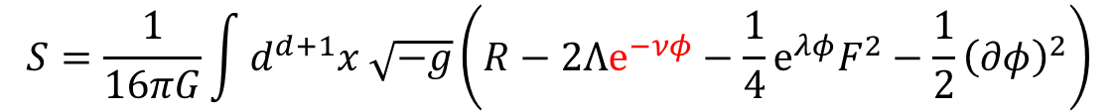


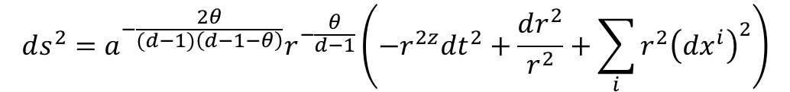
Hyperscaling-violation in geometry
To consider hyperscaling-violation, we consider the following action
$$S=\frac{1}{16πG}\int{d^{d+1}x \sqrt{−g}\left(R−2Λe^{−νφ}−\frac{1}{4}e^{λφ}F^{2}−\frac{1}{2}{\left(∂φ\right)}^{2}\right)}$$
Lifshitz spacetime solution with hyperscaling-violation
$$ds^{2}=a^{−\frac{2θ}{(d−1)\left(d−1−θ\right)}}r^{−\frac{θ}{d−1}}\left(−r^{2z}dt^{2}+\frac{dr^{2}}{r^{2}}+\sum_{i}{r^{2}{\left(dx^{i}\right)}^{2}}\right)$$
$$e^{λφ}=a^{−2−\frac{2θ}{(d−1)\left(d−1−θ\right)}}r^{−2d_{1}}$$
$$A=a\sqrt{μ} r^{z+d−1−θ}dt$$
The additional factor in the metric breaks the Lifshitz scaling symmetry
Notes:
Next, we consider the Lifshitz theory with hyperscaling-violation. In this case, we introduce additional coupling with dilaton to cosmological constant.
Then, we have this solution. Now, because of the additional factor, the metric is not invariant under the Lifshitz symmetry.

Slide 11
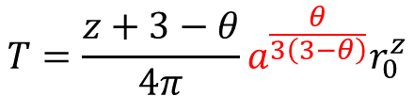


Coordinate redefinition
The black hole geometry is given by
$$d{\tilde{s}}^{2}=a^{−\frac{2θ}{3\left(3−θ\right)}}r^{−\frac{θ}{d−1}}\left(−r^{2z}fdt^{2}+2r^{z−1}dtdr+\sum_{i}{r^{2}{\left(dx^{i}−v^{i}dt\right)}^{2}}+⋯\right)$$
$$f=1−\frac{r_{0}^{z+3−θ}}{r^{z+3−θ}}$$
For hydrodynamics, we introduce $x^{μ}$-dependence to $r_{0}$, $v^{i}$ and $a$, etc.
$a(x)$ appears also in the overall factor of the metric
The background on boundary becomes non-flat
In order to have flat background, we take
$$x^{μ}→a^{\frac{θ}{3\left(3−θ\right)}}x^{μ}$$
Then, thermodynamic variables are also rescaled, for example, temperature is
$$T=\frac{z+3−θ}{4π}a^{\frac{θ}{3\left(3−θ\right)}}r_{0}^{z}$$
Notes:
For fluid/gravity correspondence, we consider the black hole geometry and introduce x-dependence into the parameters r0, v and a. The parameter a(x) appears in the overall factor of the metric. Then, this factor also appears in the background geometry on the boundary, and then, it becomes non-flat.
In order to have flat background on the boundary, we consider the coordinate redefinition.
Then, the fluid variables are also rescaled. For example, temperature has additional factor, like this.

Slide 12

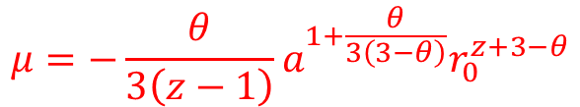

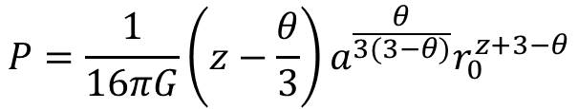

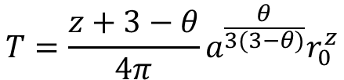
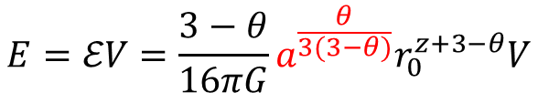

First law of thermodynamics
Energy $E$, entropy $S$ and (particle number) charge $N$
$$E=ℰV=\frac{3−θ}{16πG}a^{\frac{θ}{3(3−θ)}}r_{0}^{z+3−θ}V$$
$V$: Volume of space
$$S=sV=\frac{1}{4G}r_{0}^{3−θ}V$$
$$N=nV=\frac{z−1}{16πGa}V$$
From first law of thermodynamics
$$dE=TdS−PdV+μdN$$
Temperature $T$, pressure $P$ and chemical potential $μ$ are estimated
$$T=\frac{z+3−θ}{4π}a^{\frac{θ}{3(3−θ)}}r_{0}^{z}$$
$$μ=−\frac{θ}{3\left(z−1\right)}a^{1+\frac{θ}{3\left(3−θ\right)}}r_{0}^{z+3−θ}$$
$$P=\frac{1}{16πG}\left(z−\frac{θ}{3}\right)a^{\frac{θ}{3(3−θ)}}r_{0}^{z+3−θ}$$
Hyperscaling-violation gives non-zero chemical potential
Notes:
We consider the thermodynamic relation. In this case, the energy also has an additional factor and because of this, it depends on the charge.
This means that the chemical potential for the charge is non-zero.
From the first law, we calculate temperature, pressure and chemical potential as this.

Slide 13










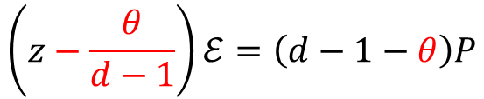
Hyperscaling-violation and scaling dimensions
Scaling dimensions in Lifshitz scaling theory in $d$-dimensional spacetime
$$\left[t\right]=−z$$
$$\left[x^{i}\right]=−1$$
$ℰ$: energy density
$$\left[ℰ\right]=z+(d−1)$$
$$\left[s\right]=d−1$$
$s$: entropy density
Due to the coordinate redefinition, the scaling dimensions are modified to
$$\left[t\right]=−z+\frac{θ}{d−1}$$
$$\left[x^{i}\right]=−1+\frac{θ}{d−1}$$
$$\left[ℰ\right]=z+\left(d−1\right)−\frac{d}{d−1}θ$$
$$\left[s\right]=d−1−θ$$
The parameter $θ$ is nothing but the hyperscaling-violation exponent.
The ward identity for the Lifshitz scaling symmetry is modified as
$$\left(z−\frac{θ}{d−1}\right)ℰ=\left(d−1−θ\right)P$$
Notes:
The coordinate redefinition gives the hyperscaling-violation. The Lifshitz theories originally has these scaling dimensions.
Due to the coordinate redefinition, the scaling dimensions are modified as this.
The ward identity for the Lifshitz symmetry is also modified as this.

Slide 14
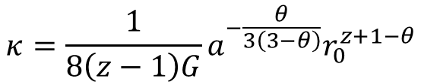








Stress-energy tensor and fluid equation
The stress-energy tensor is calculated as
$$T_{ 0}^{0}=−ℰ$$
$$T_{ 0}^{i}=−\left(ℰ+P\right)v^{i}+ησ_{ij}v^{j}+κ∂_{i}T$$
$$T_{ i}^{0}=0$$
$$T_{ j}^{i}=Pδ_{ij}−ησ_{ij}$$
The transport coefficients are given by
$$κ=\frac{1}{8\left(z−1\right)G}a^{−\frac{θ}{3\left(3−θ\right)}}r_{0}^{z+1−θ}$$
$$η=\frac{1}{16πG}r_{0}^{3−θ}$$
$$ζ=0$$
The bulk viscosity is zero even with the hyperscaling-violation
Fluid equations are given by
$$0=∂_{t}ℰ+v^{i}∂_{i}ℰ+\left(ℰ+P\right)∂_{i}v^{i}−\frac{1}{2}ησ_{ij}σ_{ij}−∂_{i}\left(κ∂_{i}T\right)$$
$$0=∂_{i}P−n∂_{i}μ−∂_{j}\left(ησ_{ij}\right)+𝒥^{μ}ℱ_{μi}$$
$$0=∂_{t}n+∂_{i}\left(nv^{i}\right)$$
Notes:
In this case, stress-energy tensor takes the same form to that without hyperscaling-violation.
The transport coefficient are calculated as this, and the bulk viscosity is zero, again.
The fluid equations are calculated as this, and it contain the effect of the non-zero chemical potential.

Slide 15
Zero bulk viscosity and dimensional reduction
The Lifshitz spacetime with hyperscaling-violation can be obtained by dimensional reduction of the Lifshitz spacetime without hyperscaling-violation.
Lifshitz black hole with hyperscaling-violation
Non-relativistic fluid with zero bulk viscosity
correspondence
Dimensional reduction
?
Dimensional reduction
correspondence
Lifshitz black hole without hyperscaling-violation
Non-relativistic fluid with zero bulk viscosity
Notes:
It is however strange that the bulk viscosity is still zero even with the hyperscaling-violation.
The Lifshitz spacetime with hyperscaling-violation can be obtained by the dimensional reduction of the Lifshits spacetime without hyperscaling violation.
If both of the Lifshitz spacetime with and without hyperscaling-violation correspond to fluids with zero bulk viscosity, this implies that the dimensional reduction of fluids with zero bulk viscosity gives fluids with zero bulk viscosity again.

Slide 16
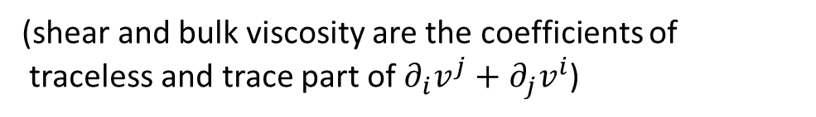


Zero bulk viscosity and dimensional reduction
However, naively, dimensional reduction of fluid with zero bulk viscosity gives fluid with non-zero (positive) bulk viscosity.
$$∂_{i}v^{j}+∂_{j}v^{i}−\frac{2}{D}δ_{ij}∂_{k}v^{k}=∂_{i}v^{j}+∂_{j}v^{i}−\frac{2}{3}δ_{ij}∂_{k}v^{k}+\frac{D−3}{3D}δ_{ij}∂_{k}v^{k}$$
(shear and bulk viscosity are the coefficients of
traceless and trace part of $∂_{i}v^{j}+∂_{j}v^{i}$)
Why Lifshitz black hole with hyperscaling-violation corresponds to fluid with zero bulk viscosity?
Volume of compactified directions is not constant but depends on the position of the other directions.
In this case, “expansion” appears in the following combination
$$Θ=∂_{i}v^{i}−b^{−1}\left(∂_{t}b+v^{i}∂_{i}b\right)$$
For $b=a$, charge conservation for $a$ gives $Θ=0$.
For $b=1$, $Θ=∂_{i}v^{i}$ is expansion and $ζ$ is bulk viscosity.
Notes:
However, naively, the dimensional reduction of fluids with zero bulk viscosity gives fluid with non-zero bulk viscosity.
The bulk viscosity is the coefficient of the trace part. The traceless shear tensor in higher dimension is given by this. This is not traceless after the dimensional reduction, and gives an additional trace part, which gives the non-zero bulk viscosity.
We have checked the dimensional reduction explicitly, and then, found that the compactification radius is not constant but depends on x. Then, the expansion appear in this combination. Here, b is related to the radius and if it is related to a, which is related to the charge density, then, This combination vanishes because of the conservation of the charge. On the other hand, if radius is constant, then, b is constant and gives non-zero bulk viscosity.

Slide 17
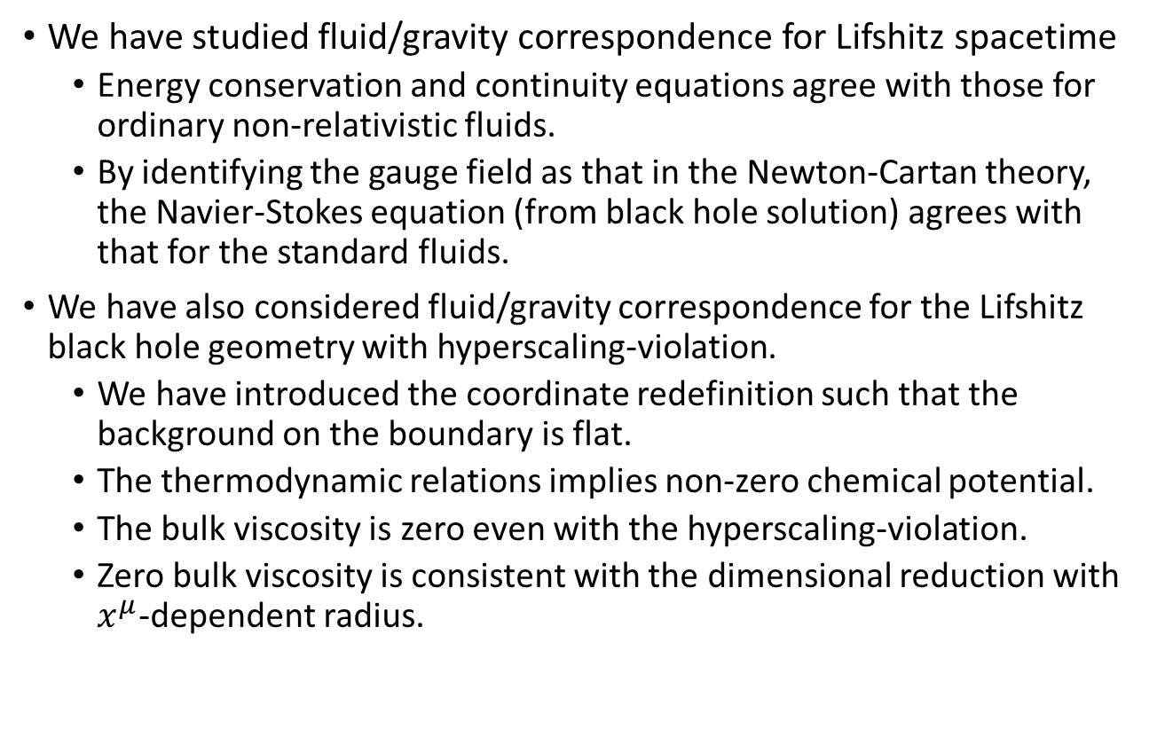
Summary
We have studied fluid/gravity correspondence for Lifshitz spacetime
  Energy conservation and continuity equations agree with those for ordinary non-relativistic fluids.
  By identifying the gauge field as that in the Newton-Cartan theory, the Navier-Stokes equation (from black hole solution) agrees with that for the standard fluids.
We have also considered fluid/gravity correspondence for the Lifshitz black hole geometry with hyperscaling-violation.
  We have introduced the coordinate redefinition such that the background on the boundary is flat.
  The thermodynamic relations implies non-zero chemical potential.
  The bulk viscosity is zero even with the hyperscaling-violation.
  Zero bulk viscosity is consistent with the dimensional reduction with $x^{μ}$-dependent radius.

Slide 18
Thank you

