Slide 1
9 Dec 2015 @ Annual Theory Meeting in NCTS, Taiwan
Dynamical Fine-Tuning of Initial Conditions
in small field inflations
Can we verify / falsify CW mechanism
in the universe ?
Is EW scale connected with Planck scale?
磯 曉 Satoshi Iso
(KEK & Sokendai)
Based on
S.Iso, K. Kohri & K. Shimada
PRD91(2015)
S.Iso, K. Kohri & K. Shimada (2015)
1511.05923

Slide 2
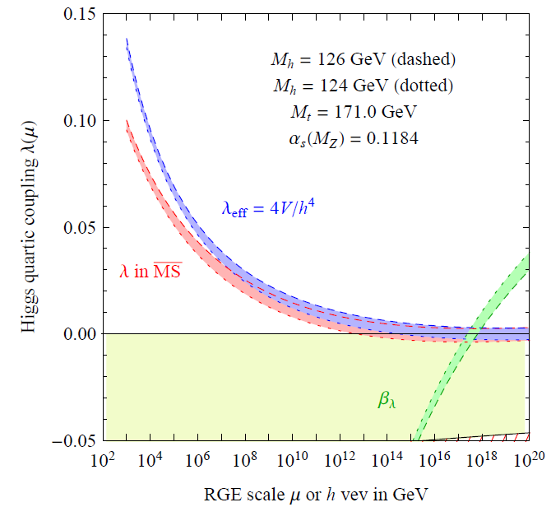
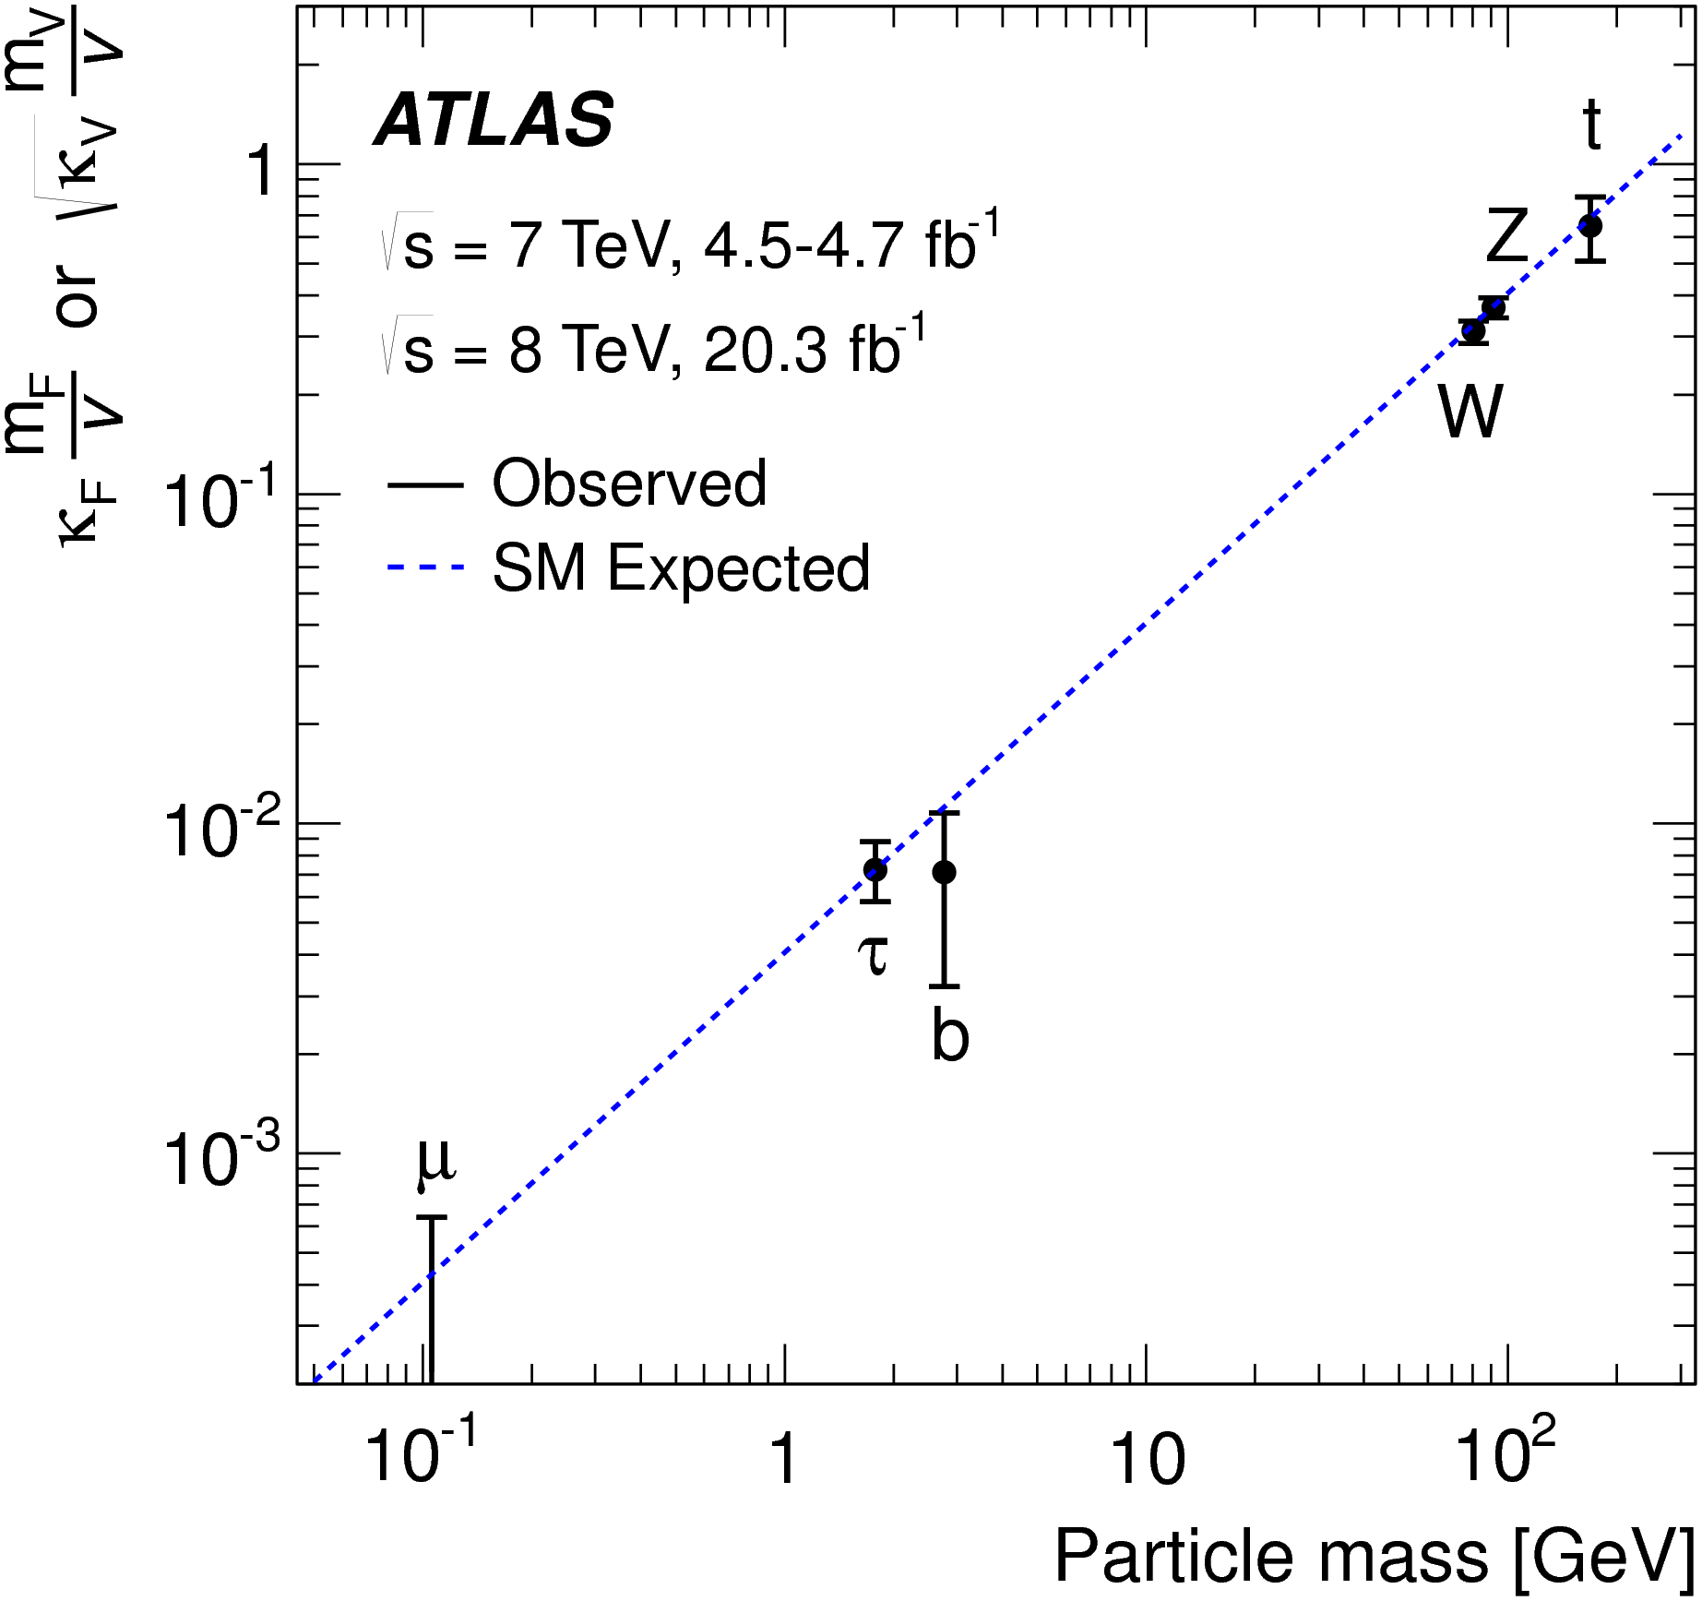
Higgs is now found !
No new physics so far.
Any small sign cannot be overlooked.
Higgs mass
Top mass
Origin of EWSB
& Flavour
EW scale may be directly related with Planck.
(H. Nielsen, M. Shaposhnikov …)

Slide 3
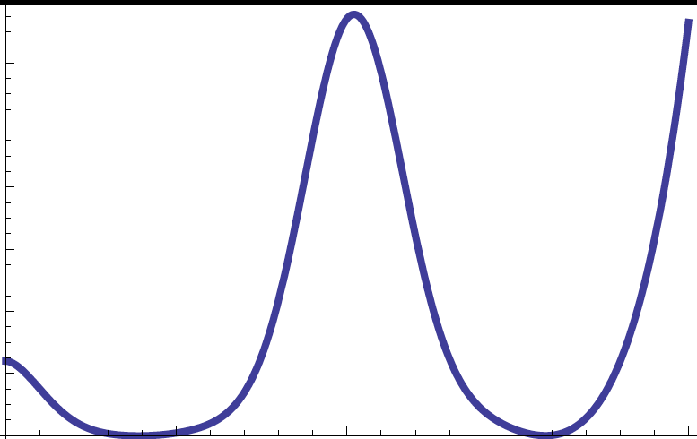
IF
Questions for UV & IR
V(φ)
M_{EW}
M_{PL}
UV question = Can string theory generate
stable SM sectors as flatland (massless scalars with λ=0) ?
IR question = How can the EWSB occur within the flatland ?

Slide 4
Coleman-Weinberg mechanism for EWSB
Extension of SM is necessary !
(B-L) extension of SM with flat Higgs potential at Planck
B-L sector
・U(1)_{B-L} gauge
・SM singlet scalar φ
・Right-handed ν
SM
2 important couplings
λ: quartic coupling of φ (B-L scalar)
g: B-L gauge coupling
λ ~ g⁴

Slide 5
How can we test UV & IR properties of ?
UV： Any low energy consequence of flatland ?
IR: Coleman-Weinberg mechanism with B-L sector
→ various collider signals (Z’ ν_{R} etc)
In this talk, I will show
CW mechanism can be verified/falsified in cosmology

Slide 6
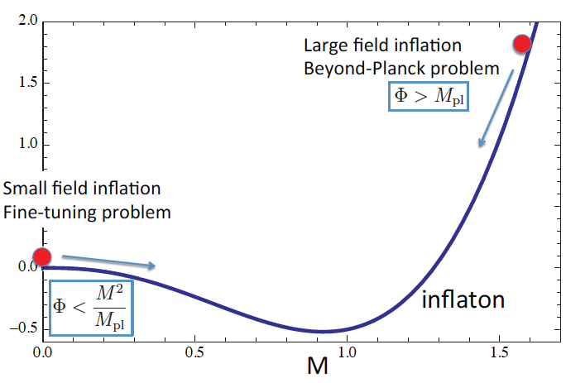
Inflationary universe in Coleman-Weinberg model
φ: B-L scalar (SM singlet)
Cosmological scenario
Large Field Inflation
Z’ creation by Preheating
Trapping the inflaton around φ =0
Small Field Inflation → CMB fluctuations
Roll down → reheating → SSB of B-L → EWSB is triggered

Slide 7

Conclusion of my talk
Kohri Shimada SI
2015
If EW scale is radiatively generated by CW,
(inflaton = scalar in B-L sector)
The field is trapped around the orign, and
small field inflation (SFI) inevitably occurs after LFI
(2) The initial condition of SFI is dynamically
fine-tuned with the value

Slide 8
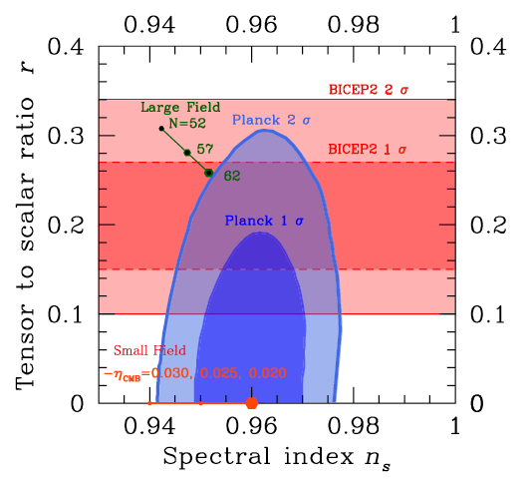
Large vs Small field inflations for CMB predictions
(1) LFI (chaotic)
→
LFI
・ Large tensor to scalar ratio
・ Beyond Planck problem φ > M_{PL}

Slide 9
(2) SFI
Slow roll condition →
10⁻⁹
c= 0.01
Flat potential
SFI
・ Tiny tensor to scalar ratio
・ Unnaturally-looking initial condition φ << M

Slide 10

How unnatural is the initial condition in SFI ?
φ_{ini} = 10⁻¹⁵ M for M=10 TeV
M

Slide 11
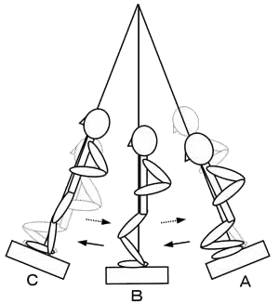
(Kofman Linde Starobinsky 1996)
Review of Preheating
・ Preheating is non-perturbative particle productions
・ Oscillation of inflaton φ → production of χ (=Z’)
Mathieu eq.

Slide 12
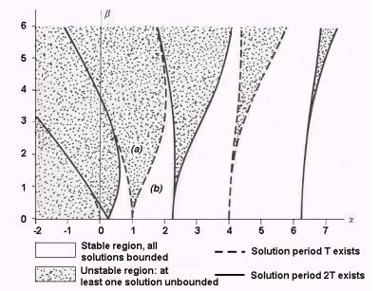


q
q >1 Broad resonance
irrespective of A
q <1 narrow resonance
only for A = (integer/2)²
A
q varies with time as
at the beginning: g²/λ >> 1 → later: 1

Slide 13
Properties of preheating
1 Rapid production due to Bose enhancement
2 Low momentum particles are produced
non-equilibrium distribution
→ anomalously large fluctuations
3 Inflaton potential is largely modified
→ Trapping the field around the origin
varies with time
(or the classical field value)

Slide 14
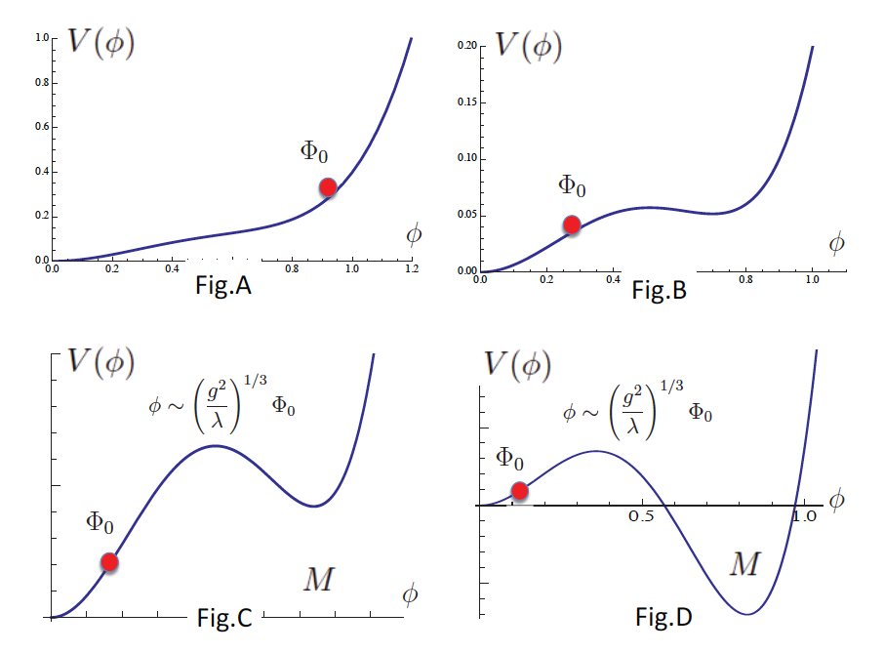
Trapping of field around the origin

Slide 15
How fine-tuned is the initial condition in SFI ?
φ_{ini} = 10⁻¹⁵ M for M=10 TeV
M

Slide 16


Dynamical fine-tuning of initial condition
・ When does SFI start?
Vacuum energy
Radiation energy
Inflaton continues to oscillate and amplitude decays.
・ When does oscillation freeze? → H > m_{eff}
→

Slide 17
In the Coleman-Weinberg scenario of EWSB,
SFI inevitably occurs due to the trapping of field at φ=0
and
initial condition is dynamically fine-tuned
due to the absence of –m² φ² term at φ=0
CW model predicts SFI with tiny r
(ε =10⁻⁴ |η|³ (M/M_{PL})⁴ =10⁻⁴⁰ for M=10¹⁰ GeV )
Observation of tensor mode will kill CW scenario.

Slide 18
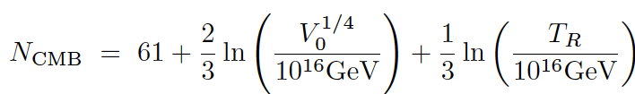
Another Problem in the SFI
predicted n_{s} is smaller
→
r =16ε ~ 0
V₀ = (TeV)⁴ → N_{CMB} ~ 30
V₀ = (10¹⁰ GeV)⁴ → N_{CMB} ~ 47

Slide 19





How can we enlarge n_{s} ?
(a) non-minimal coupling (quadratic potential)
(b) Generation of linear term by fermion condensate
Linear potential is generated
(b1) condensate of RH neutrino
or
Kohri Shimada SI 2014
(b2)
linear potential for Higgs
Because of the scalar mixing
linear potential for φ is generated !
scalar mixing
chiral condensate

Slide 20
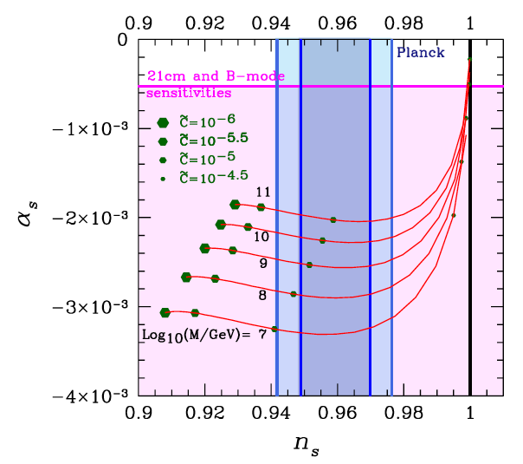




running of n_{s}
Small field CW inflation can be consistent with the observed n_{s}
if we include the effect of chiral condensate and scalar mixing.

Slide 21
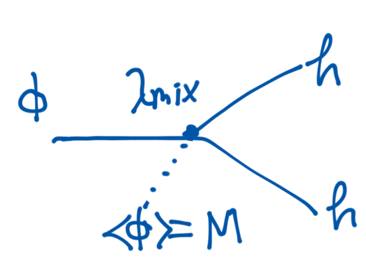
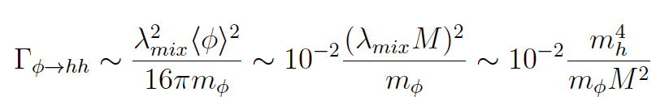


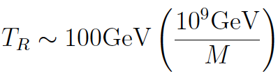
Reheating after SFI
Inflaton : mixing with Higgs
M < 10⁹ GeV

Slide 22
Summary
1. Stability of EW scale and M_{H} =125 GeV suggests
EW is dynamically generated from flat Higgs potential at M_{PL}
→ CW mechanism is favoured.
2. Preheating generates potential for inflaton and trap the scalar
→ Small Field Inflation occurs.
3. Unnaturally-looking initial condition is dynamically realized !
4.Small n_{s} problem can be solved by chiral condensation at h=0.
CW scenario can be tested in the universe

Slide 23
Thank you
謝謝

